Slide 1
REPORT
23.06.2025
Ilia Polishchuk

Slide 2
Major milestones
The BS thesis was defended with an A grade
I was admitted to the UAB master’s programme in HEP

Slide 3
Final plans
Publish my work about ω- and φ-mesons

Slide 4
Fit systematic
During the third week of June final fit systematic uncertainty values were reevaluated

Slide 5
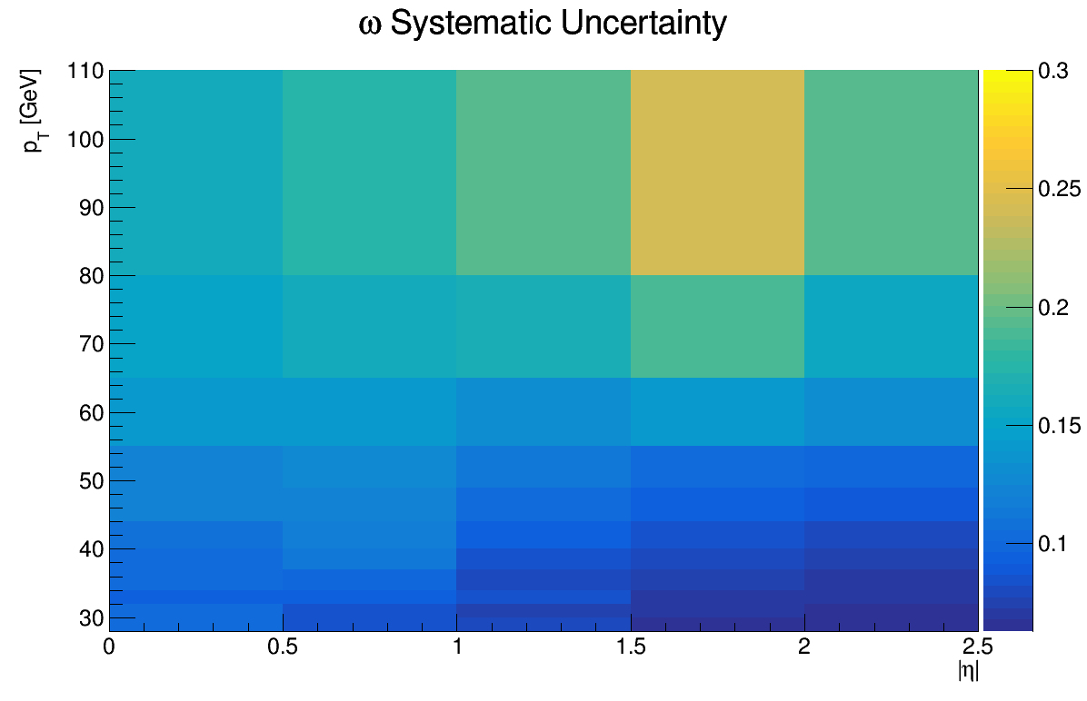
Fit systematic ω

Slide 6
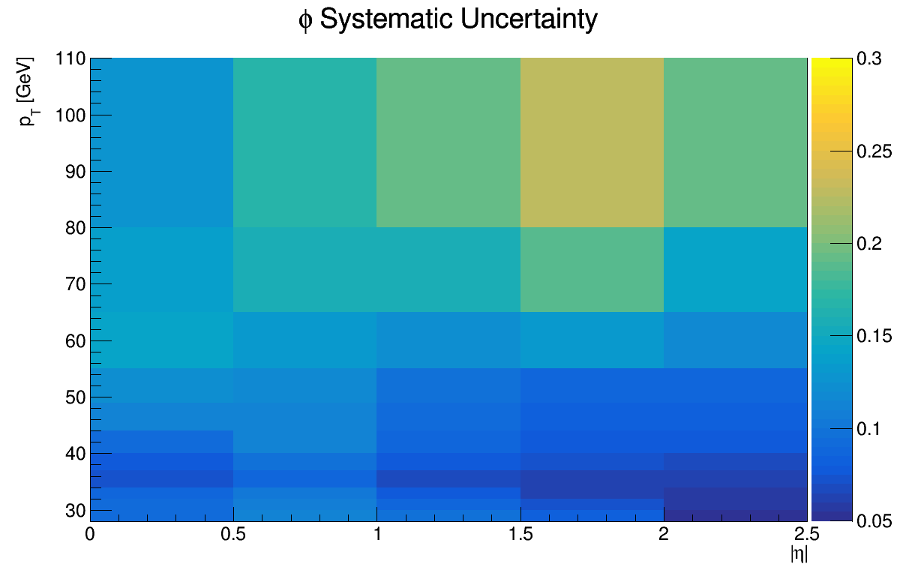
Fit systematic phi

Slide 7
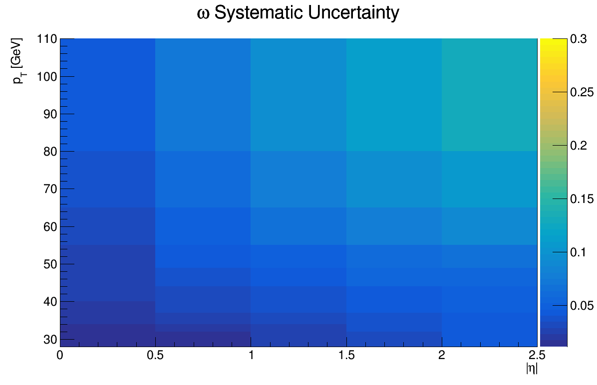
Fit systematic prompt J/Psi

Slide 8
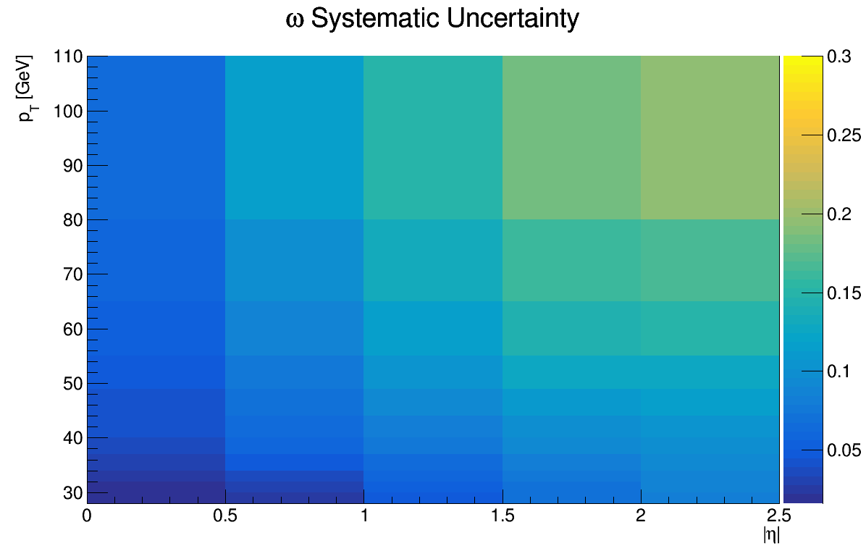
Fit systematic nonprompt J/Psi

Slide 9
THANK YOU FOR YOUR ATTENTION

