Slide 1
REPORT
09.06.2025
Ilia Polishchuk

Slide 2
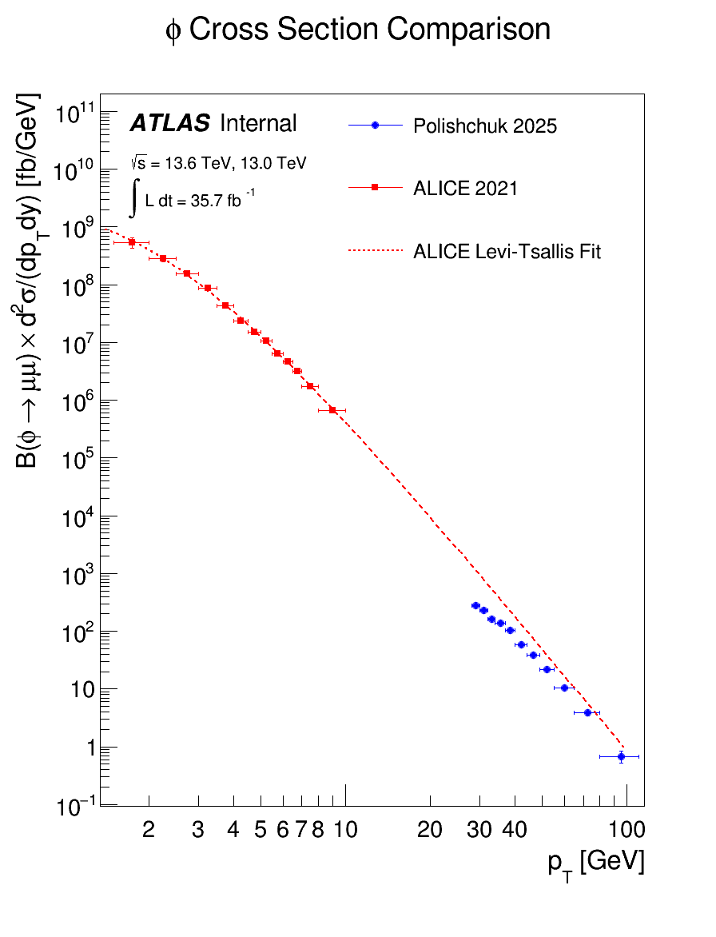
Phi-meson comparison

Slide 3
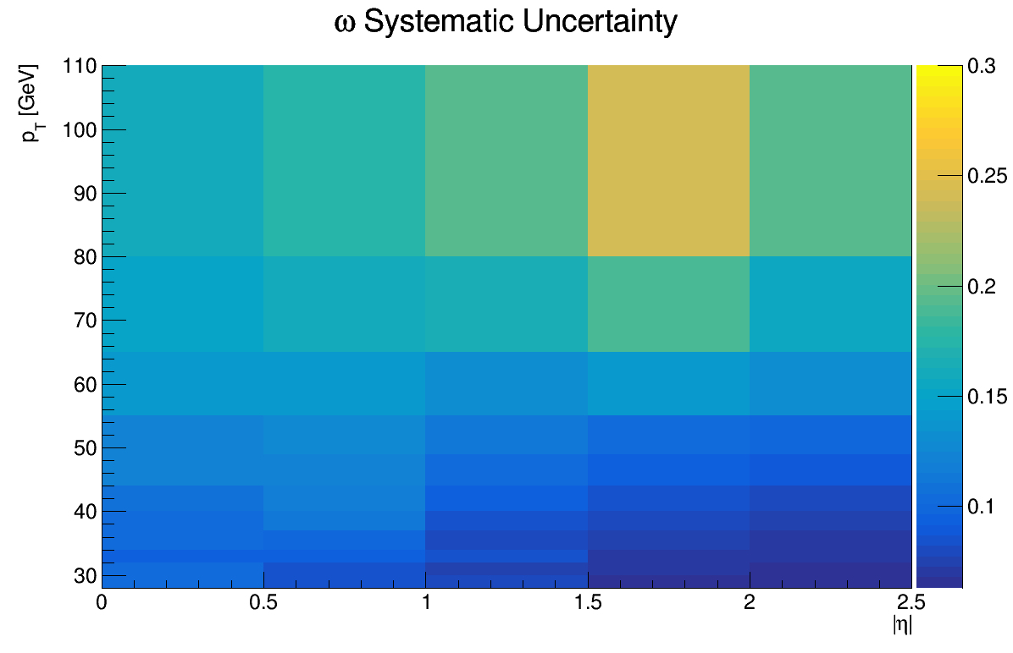
Fit systematic ω

Slide 4
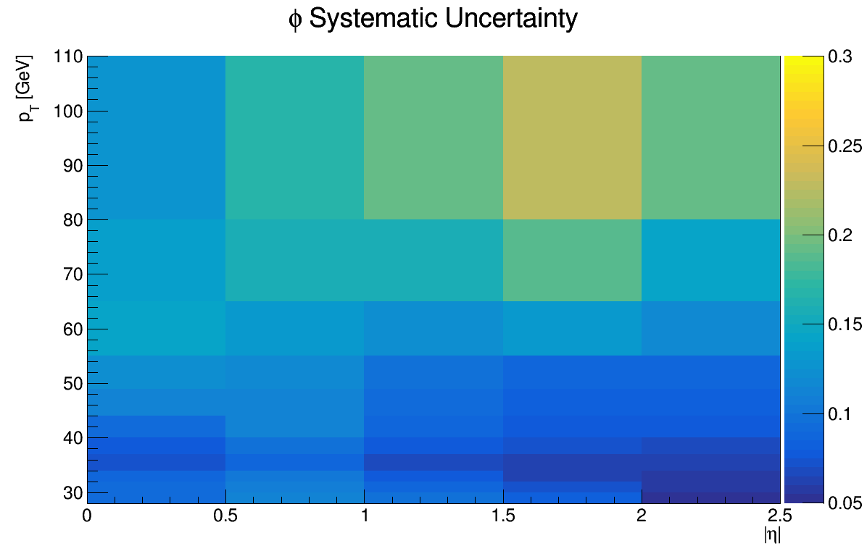
Fit systematic phi

Slide 5
THANK YOU FOR YOUR ATTENTION

