Slide 1
Neda Firoz
Junior Research Fellow
Introduced myself to the lab and familiarized myself with the Twiki platform guidelines.
Consulted with Maria Didenko to troubleshoot installation and access issues.
Explored ROOT basics via the Twiki “Quick Start” guide;
Ran one BDT but with not so satisfactory results and just for getting used to the platform
Report
10th July 2025

Slide 2
Progress 1st Week
Did not succeed in the running of condor
Reading on data format because of some confusions
Have to discuss with Dimitry about the errors and how to trouble shoot the errors
Today I was trying to run the BDT on Condor after the discussion on data on Monday and NTuples format with Maria
Introduced myself to the lab and familiarized myself with the Twiki platform guidelines.
Consulted with Maria Didenko to troubleshoot installation and access issues.
Explored ROOT basics via the Twiki “Quick Start” guide;
Ran one BDT but with not so satisfactory results and just for getting used to the platform

Slide 3
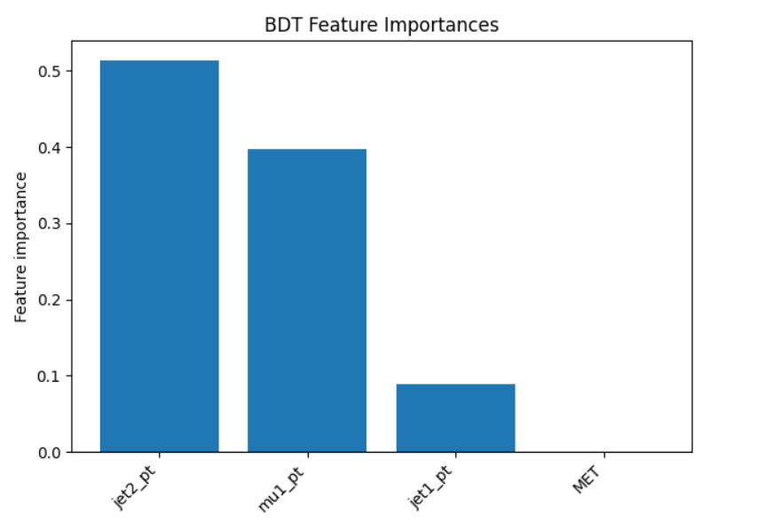
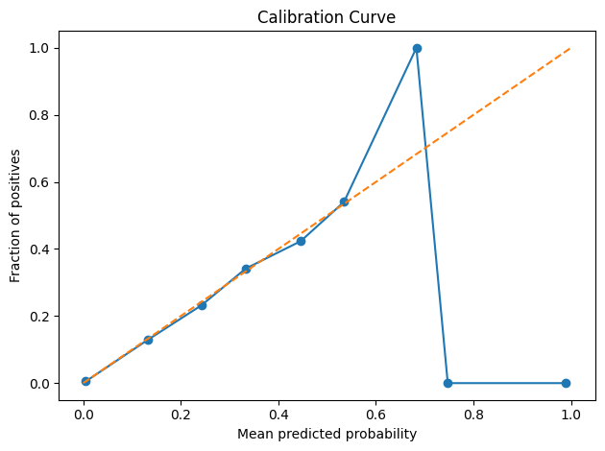
Progress 2nd Week
Did not succeed in the running of condor
Reading on data format because of some confusions
Have to discuss with Dimitry about the errors and how to trouble shoot the errors
Today I was trying to run the BDT on Condor after the discussion on data on Monday and NTuples format with Maria

Slide 4
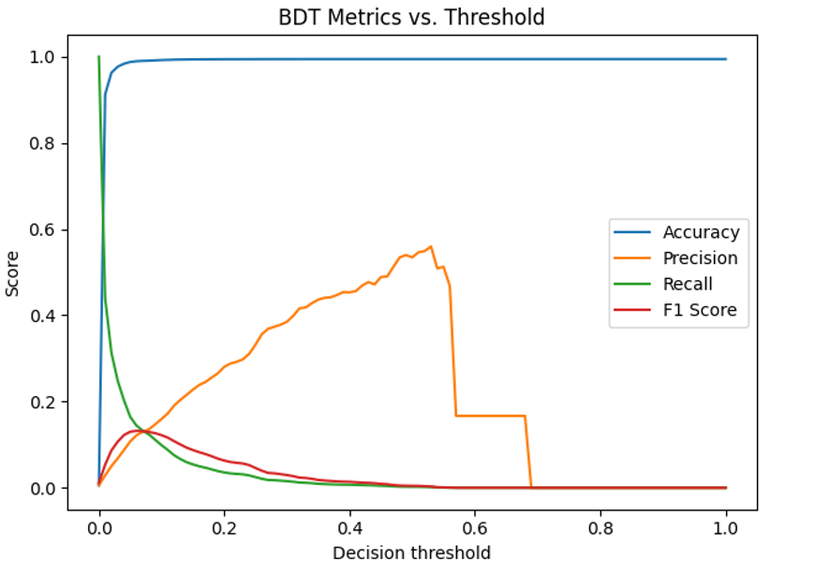
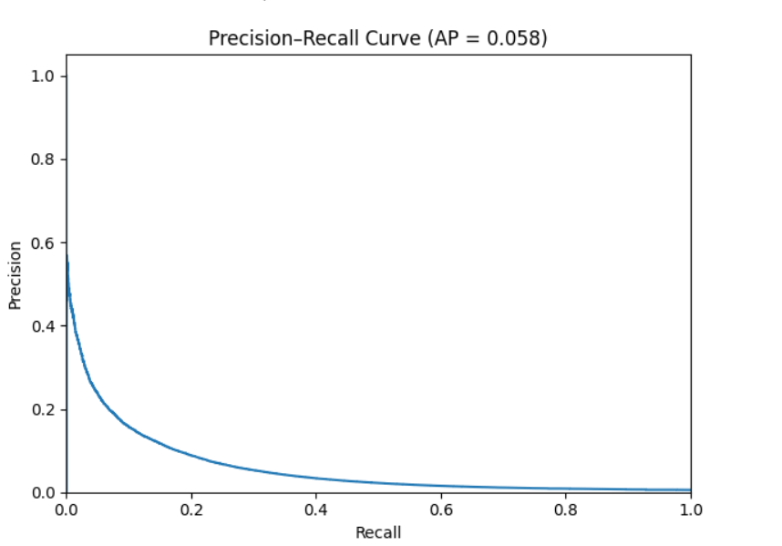
Initial Results With BDT-1

Slide 5
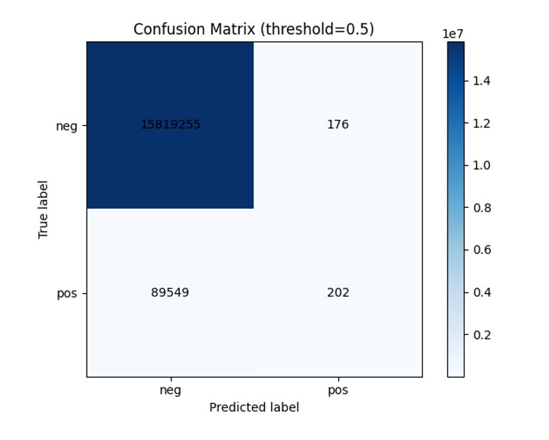

Slide 6
Reading more on the Article and Working on suggestions received by Maria for BDT training
Reviewing the DAOD_PHYSLITE (2015–2016) data format in preparation for analysis.

Slide 7
THANK YOU !
Reviewing the DAOD_PHYSLITE (2015–2016) data format in preparation for analysis.
Reading more on the Article and Working on suggestions received by Maria for BDT training

Slide 8
THANK YOU !

