Slide 1
REPORT
15.05.2025
Ilia Polishchuk

Slide 2
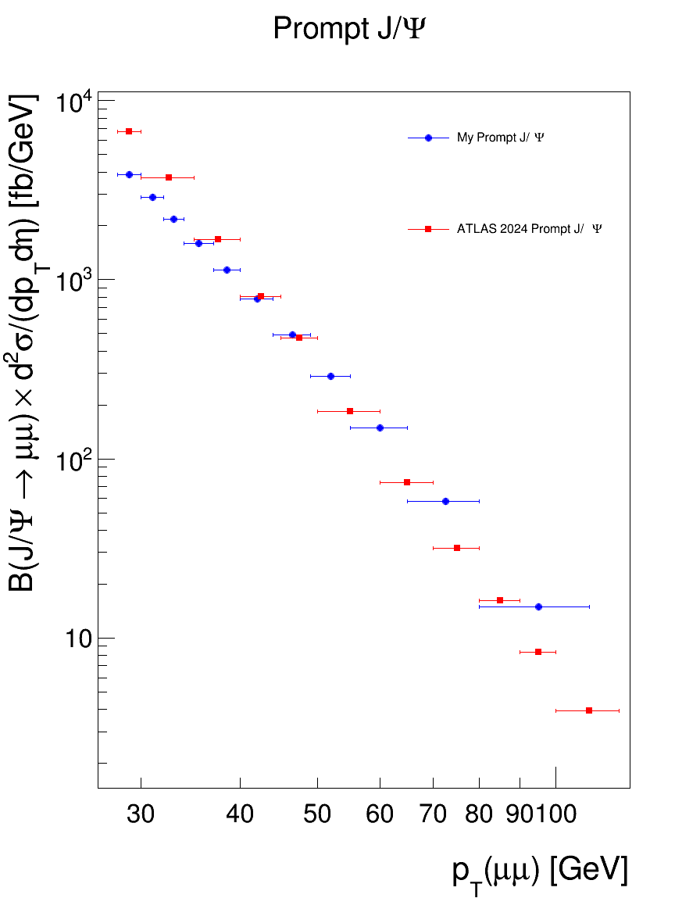
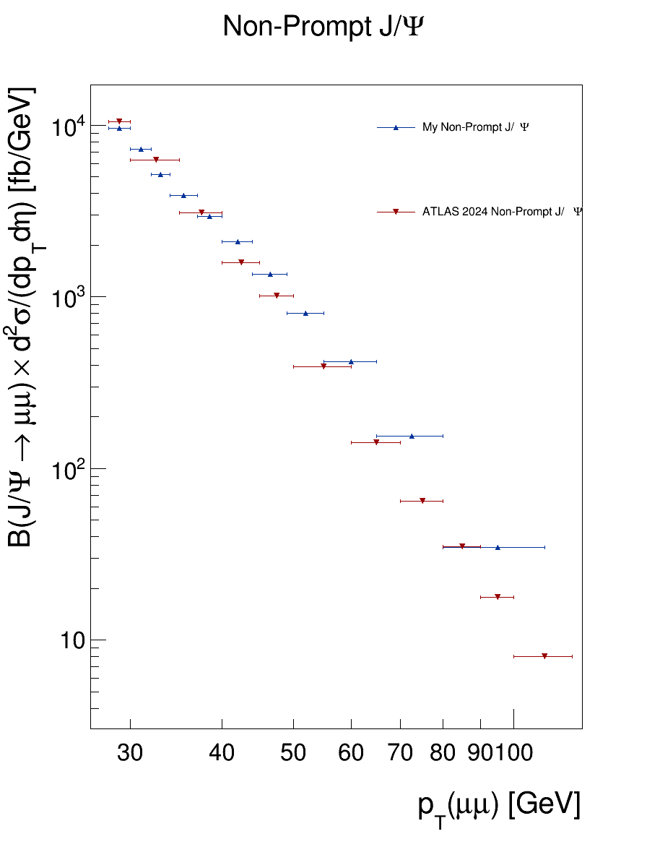
$$1.5<\left|η\right|<2.0$$
J/Psi cross section comparison

Slide 3
THANK YOU FOR YOUR ATTENTION

