Slide 1
REPORT
08.05.2025
Ilia Polishchuk

Slide 2
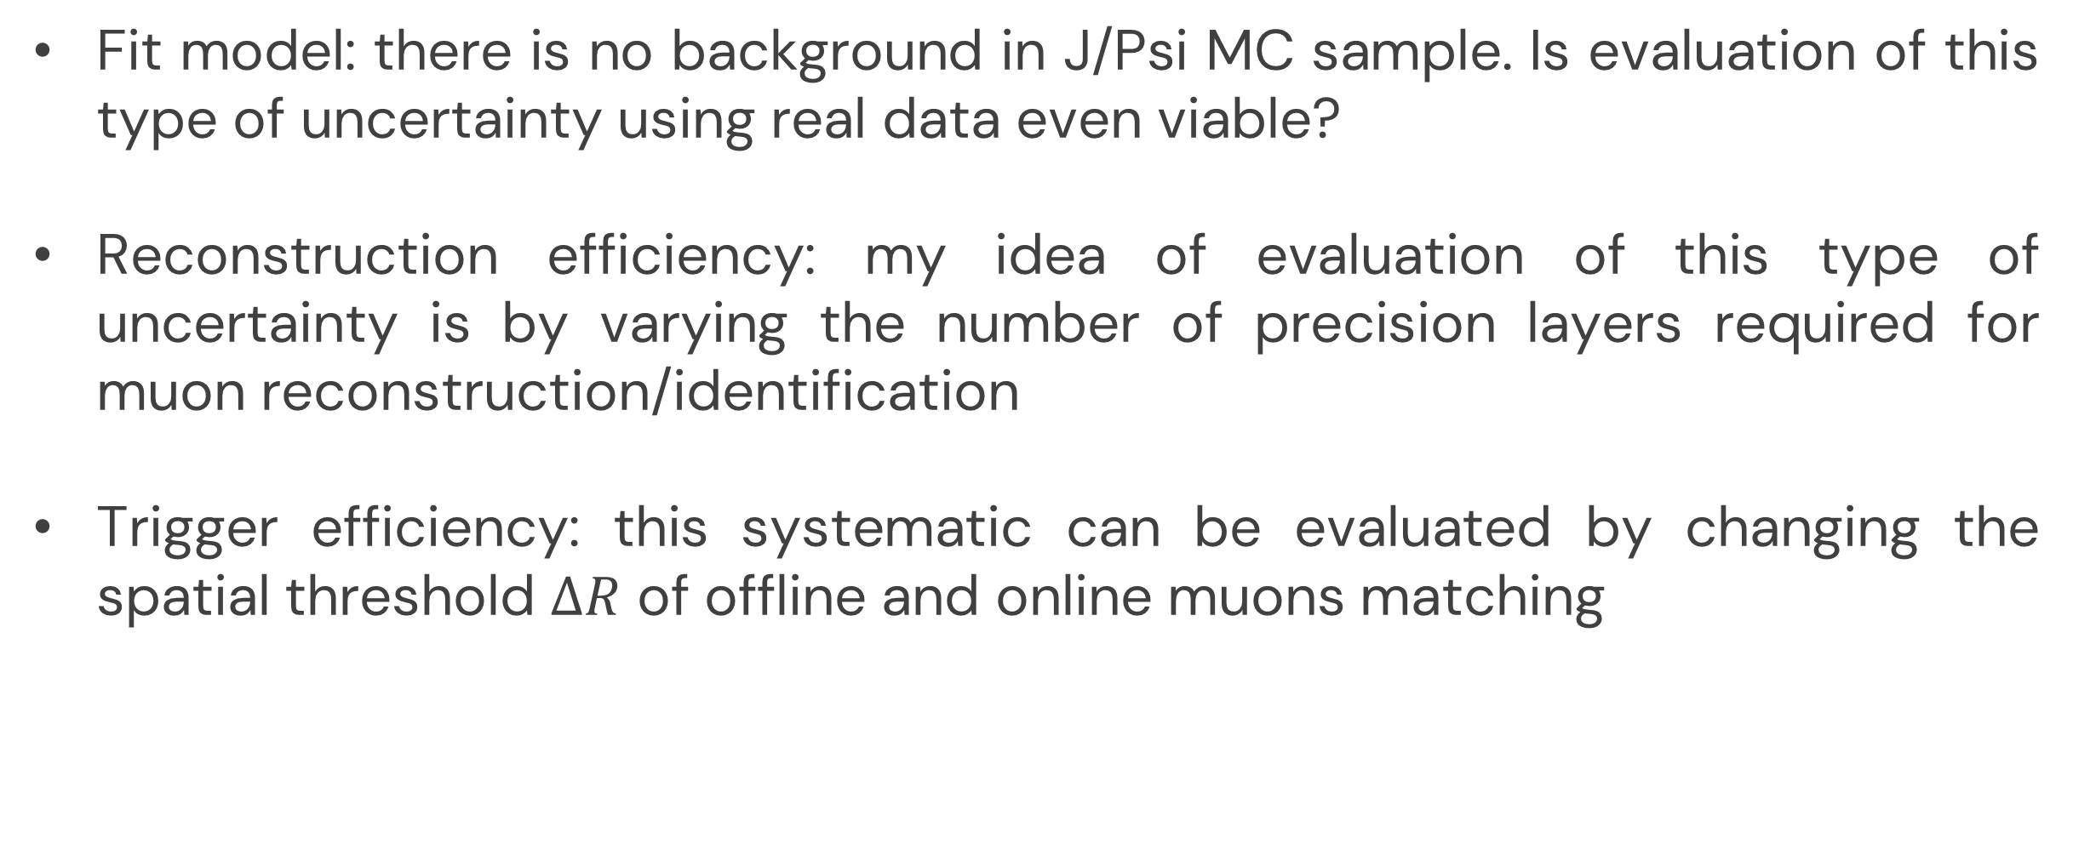
Systematic uncertainties
Fit model: there is no background in J/Psi MC sample. Is evaluation of this type of uncertainty using real data even viable?
Reconstruction efficiency: my idea of evaluation of this type of uncertainty is by varying the number of precision layers required for muon reconstruction/identification
Trigger efficiency: this systematic can be evaluated by changing the spatial threshold $∆R$ of offline and online muons matching

Slide 3
THANK YOU FOR YOUR ATTENTION

