Slide 1



REPORT
18.02.2025
Ilia Polishchuk

Slide 2
BINP

Slide 3
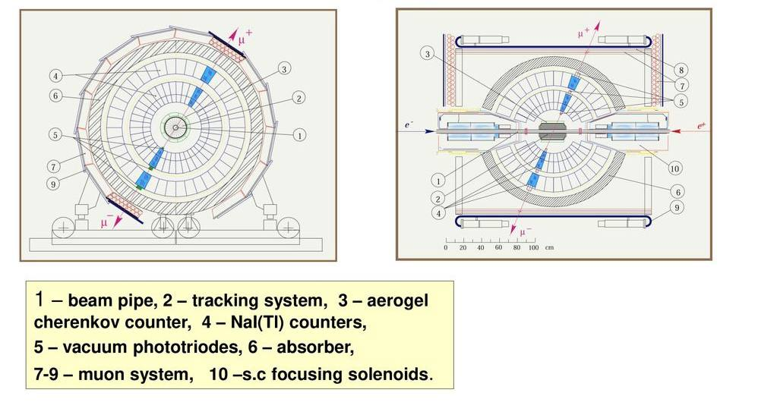
SND

Slide 4
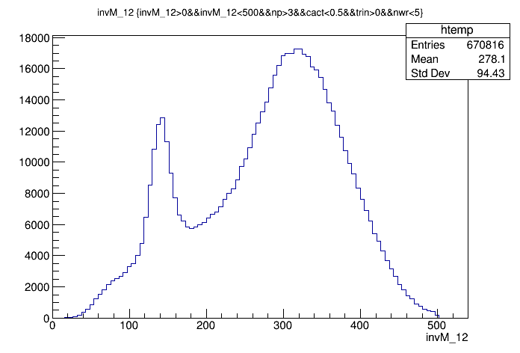
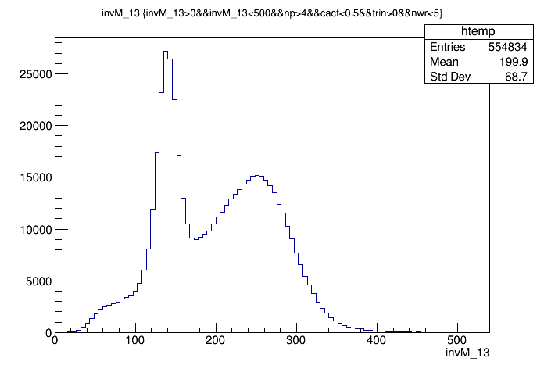
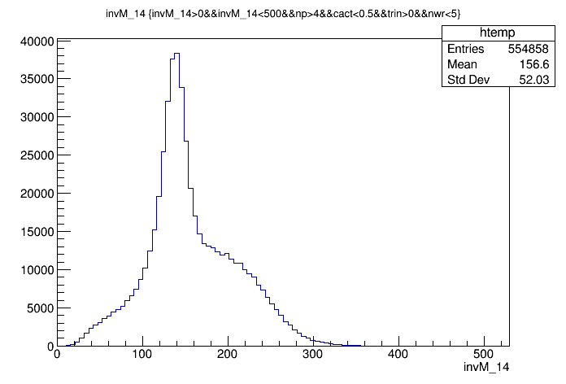
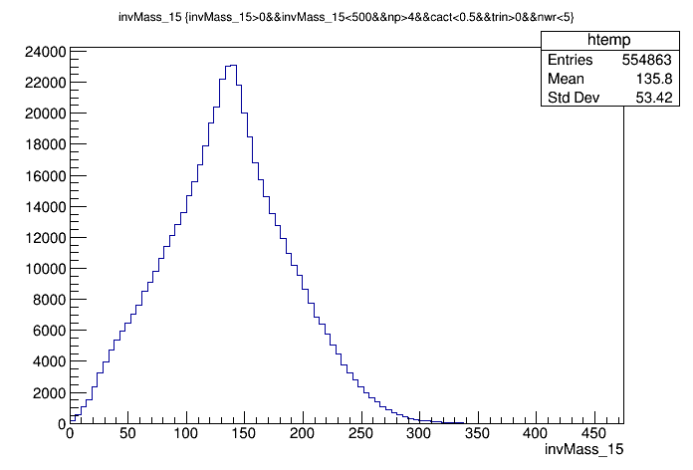
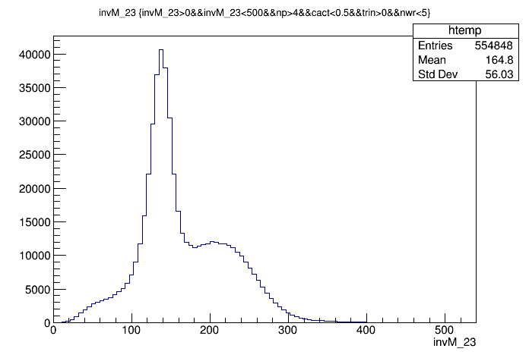
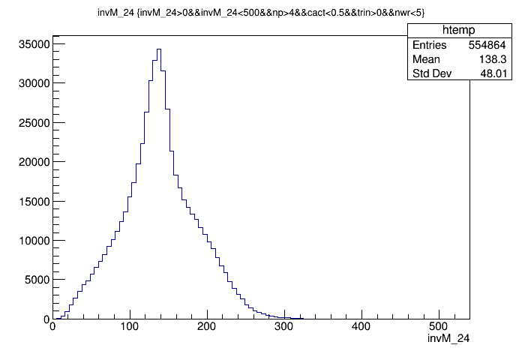
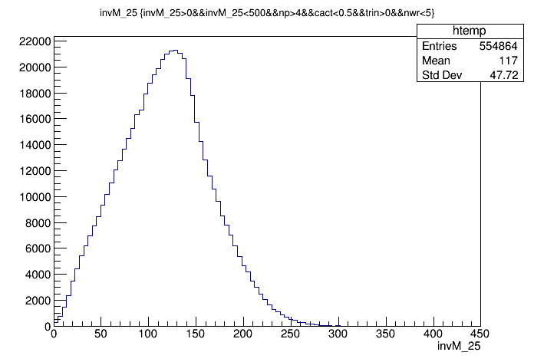
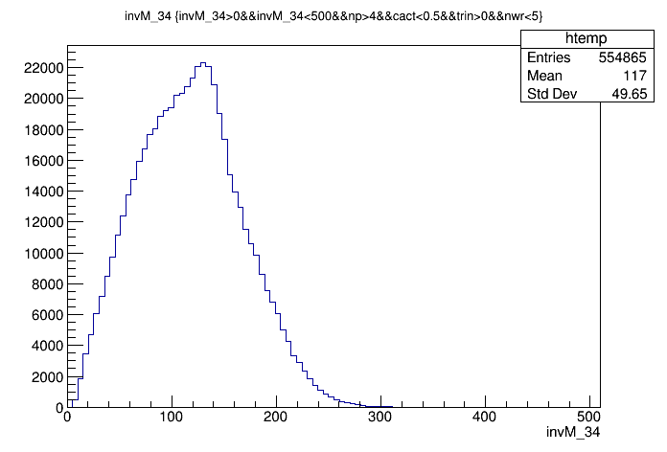
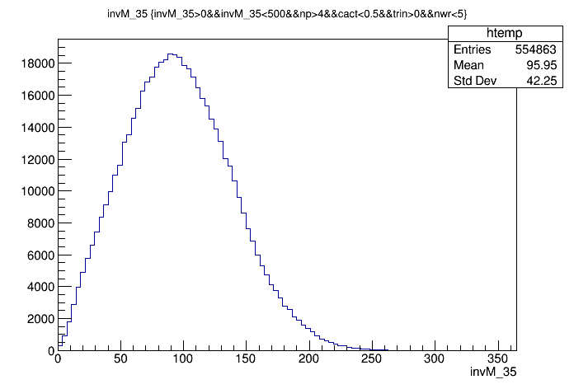
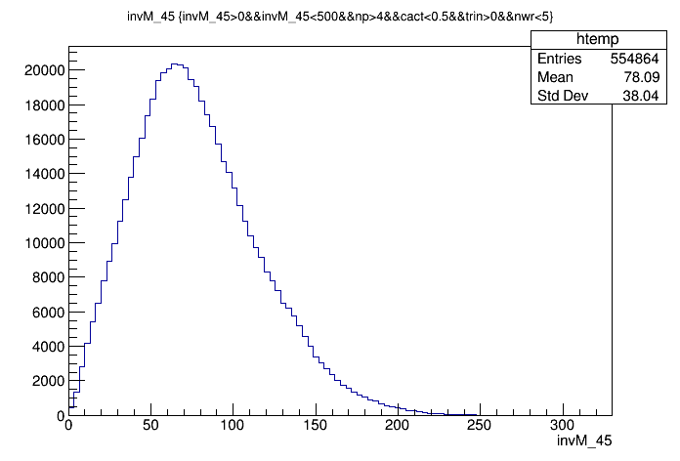
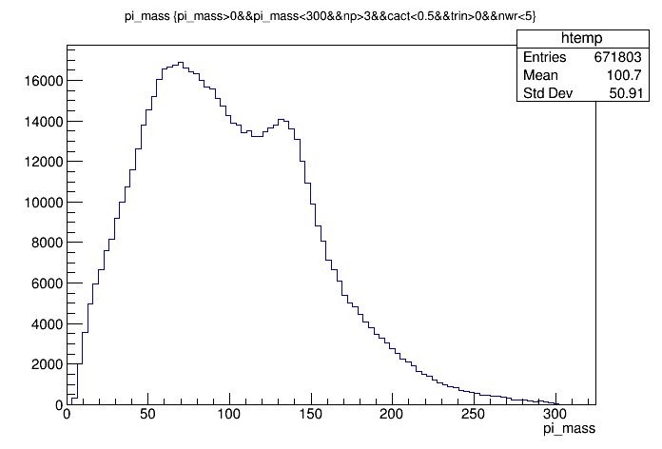
Pi-meson candidates

Slide 5
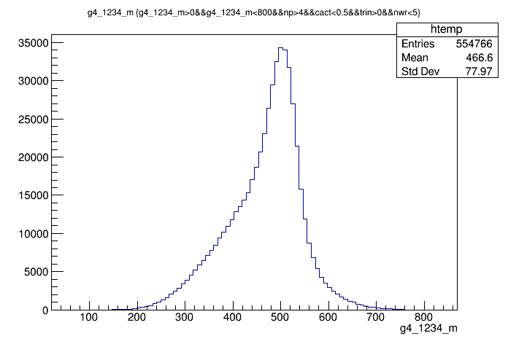
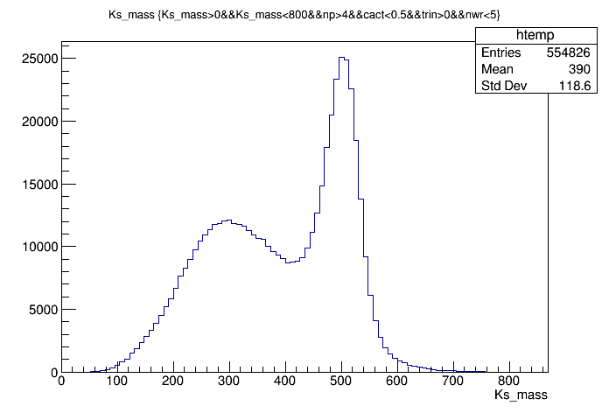
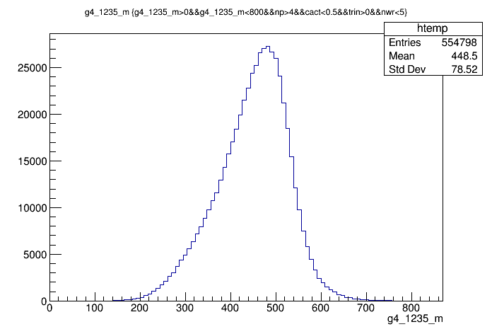
Ks-meson

Slide 6
ATLAS

Slide 7
Average acceptance
The average acceptance is defined as the fraction of the number of simulated decays in
the probe sample divided by
the total number of simulated decays.
For 99267 simulated decays there are 53650 truth muons with |η| < 2.5 and Pt > 10 GeV.
Therefore the average acceptance is calculated to be 54,04%

Slide 8
THANK YOU FOR YOUR ATTENTION

