Slide 1
REPORT
31.03.2025
Ilia Polishchuk

Slide 2
ATLAS

Slide 3
Acceptance
The total acceptance A is defined as the fraction of the number of simulated decays in
the probe sample divided by
the total number of simulated decays.
$$\begin{aligned}A= A_{kin}∗ε_{rec}∗ε_{trig}\#\#\#\#\#\#\#\#\left(1\right)\#\end{aligned}$$
Where $A_{kin}$ is probability that J/ψ passes the following acceptance selections imposed on the two muons depending on a trigger:
$p_{T}\left(μ_{1}\right)>10 GeV,p_{T}\left(μ_{2}\right)>10 GeV;$ $\left|η\left(μ_{1}\right)\right|<1.0,\left|η\left(μ_{2}\right)\right|<1.0$
$p_{T}\left(μ_{1}\right)>14 GeV,p_{T}\left(μ_{2}\right)>14 GeV;$ $\left|η\left(μ_{1}\right)\right|<2.5,\left|η\left(μ_{2}\right)\right|<2.5$
$$ε_{rec}=\frac{N_{rec}}{N_{true}}, ε_{trig}=\frac{N_{trig}}{N_{rec}}$$
Trigger chains: HLT_2mu10_l2mt_L1MU10BOM and HLT_2mu14_L12MU8F

Slide 4
Acceptance
Total acceptance for trigger chain HLT_2mu14_L12MU8F is calculated for following fiducial regions:
25 regions of $p_{T}$ ranging from 28 GeV to 108 GeV
5 regions of $\left|η\right|$ ranging from 0.0 to 2.5

Slide 5
Cross sections
Differential cross section $\frac{dσ}{dp_{T}}$ of $J/ψ→μμ$ is calculated using formula:
$$\begin{aligned}\frac{dσ}{dp_{T}}\left(J/ψ→μμ\right)=\frac{N_{pT}^{yield}}{A_{pT}∗L∗∆p_{T}}\#\#(2)\end{aligned}$$
Where $N_{pT}^{yield}−$ total yield of signal in $p_{T}$ bin, $L=35.7{fb}^{−1}−$ integrated luminosity, $∆p_{T}−$ width of $p_{T}$ bin.
For $\frac{dσ}{d\left|η\right|}$ I used following formula:
$$\begin{aligned}\frac{dσ}{d\left|η\right|}\left(J/ψ→μμ\right)=\frac{N_{η}^{yield}}{A_{\left|η\right|}∗L∗∆η}\#\#(3)\end{aligned}$$
Where $N_{η}^{yield}−$ total yield of signal in $y$ bin $∆η−$ width of $y$ bin.
Double differential cross section $\frac{d^{2}σ}{d\left|η\right|dp_{T}}$ of $J/ψ→μμ$ is calculated using formula:
$$\begin{aligned}\frac{d^{2}σ}{d\left|η\right|dp_{T}}\left(J/ψ→μμ\right)=\frac{N_{η,pT}^{yield}}{A_{η,pT}∗L∗∆p_{T}∗∆η}\#\#(4)\end{aligned}$$

Slide 6
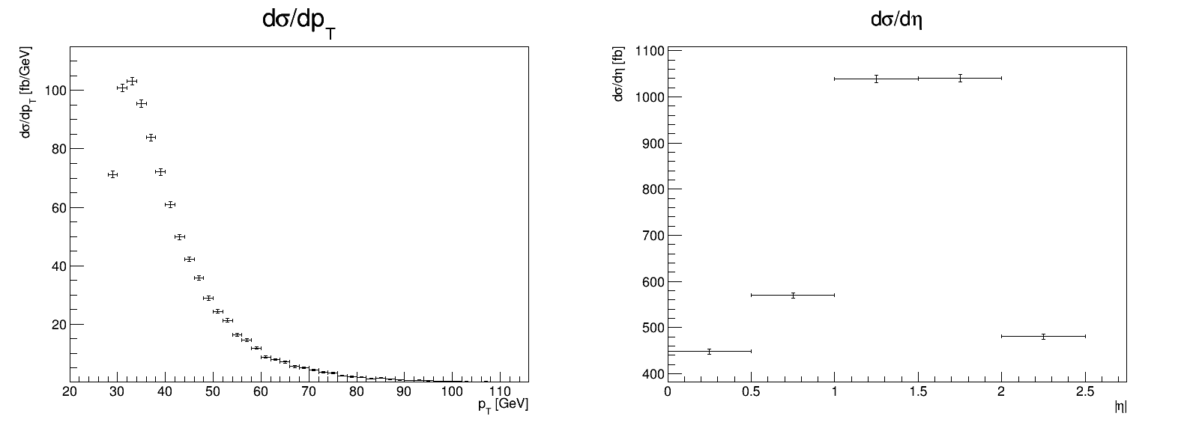
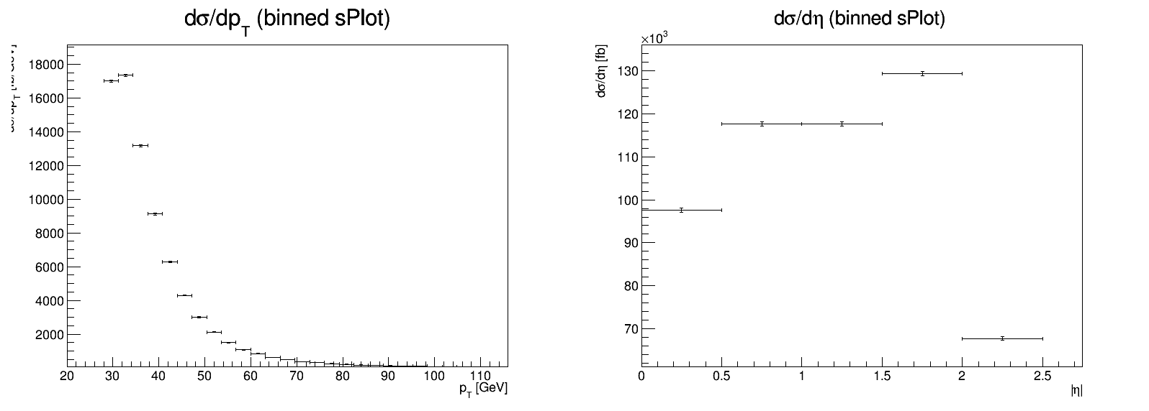
Differential cross sections
Trigger chain: HLT_2mu14_L12MU8F
Data without acceptance
Monte Carlo

Slide 7
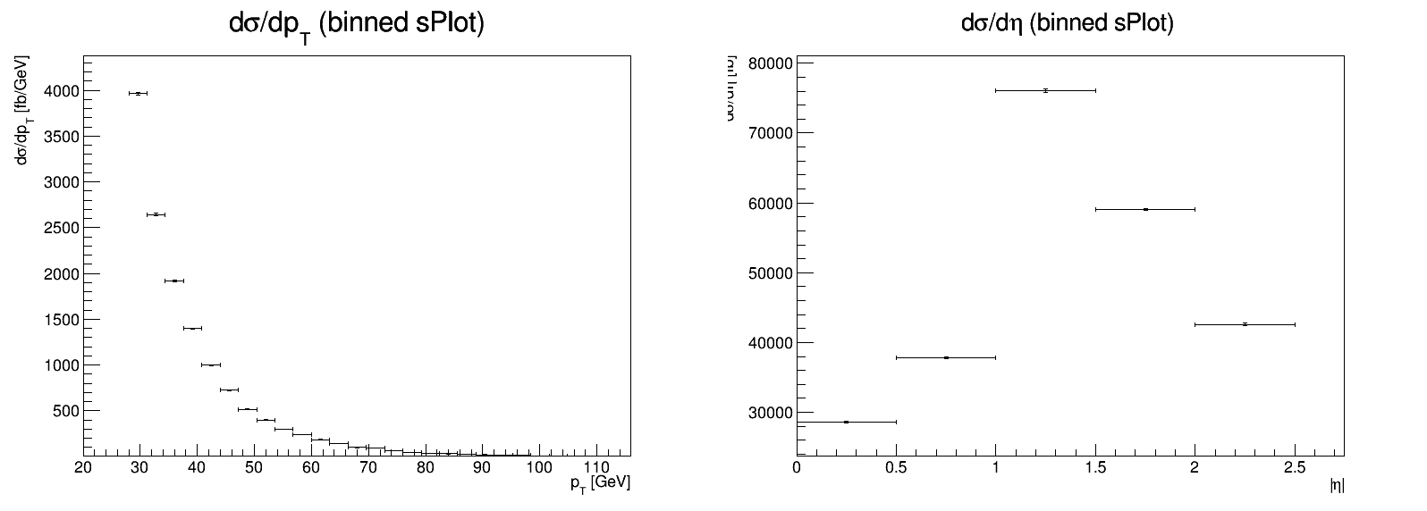
Differential cross sections
Trigger chain: HLT_2mu14_L12MU8F
Data without acceptance
Monte Carlo

Slide 8
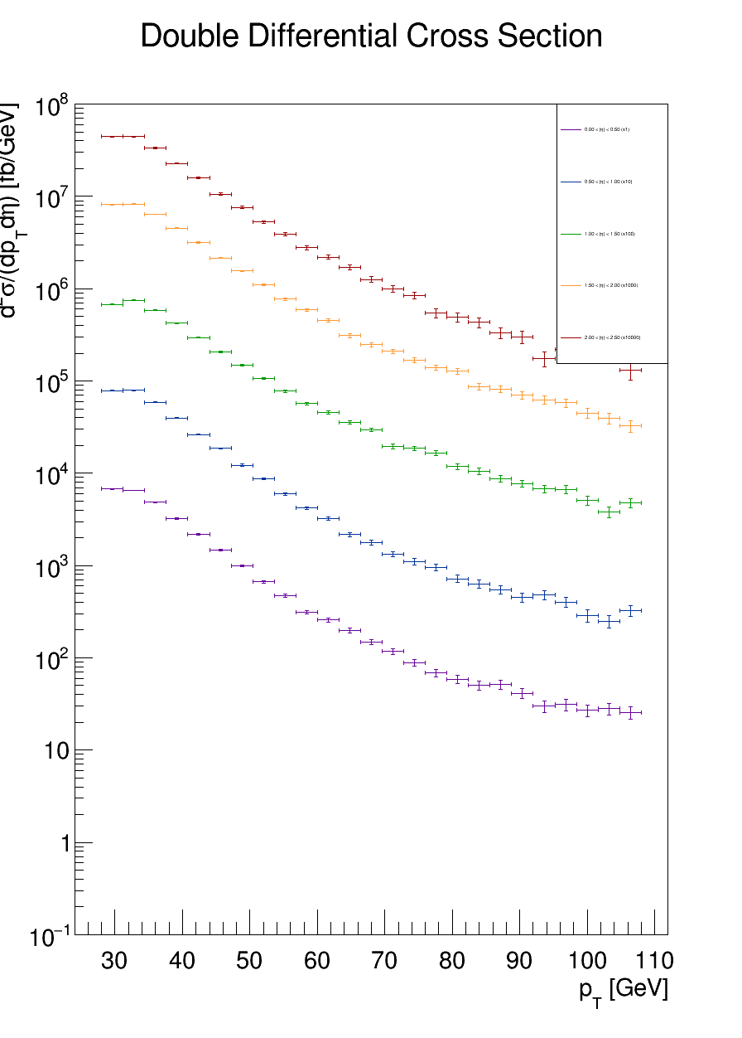
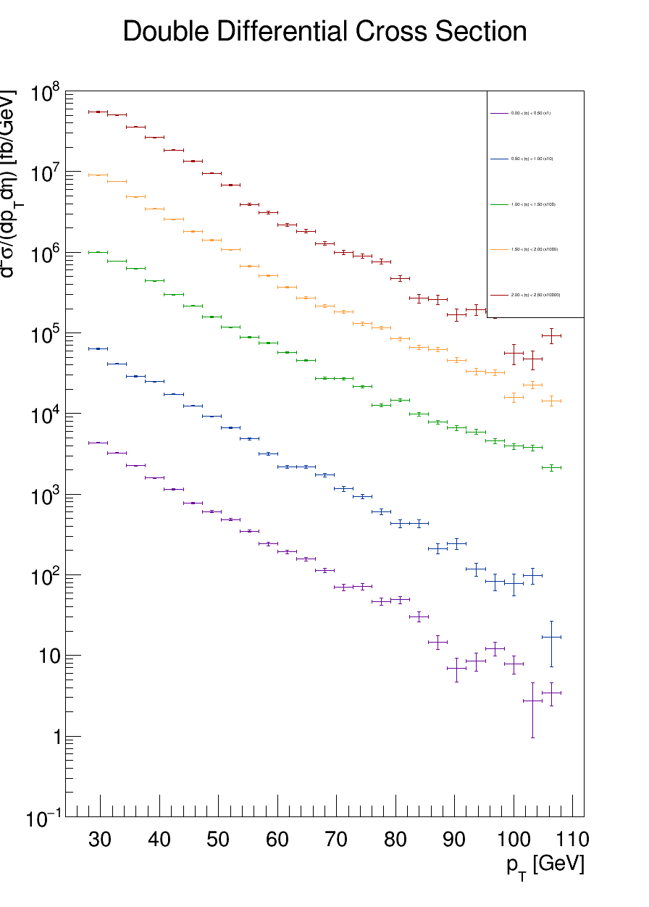
Double Differential cross sections (log scale)
Monte Carlo
Data with acceptance

Slide 9
Systematic uncertainties
Main sources of systematic uncertainties:
Luminosity
Acceptance
Reconstruction efficiency
Trigger efficiency
Fit models

Slide 10
THANK YOU FOR YOUR ATTENTION

