Slide 1
Simulation of deuteron-deuteron interactions in Geant4
Nikita Chalyi, Tomsk State University (TSU)
Supervisor: Aida Galoyan, LHEP JINR

Slide 2
Content
In this work we consider deuteron-deuteron inelastic, quasielastic and elastic interactions in Geant4 11.3
Current work was made under supervision of leading researcher LHEP JINR Aida Galoyan as a part of pre-graduate practice from 3 to 30 march 2025
Version of Geant4: 11.3.ref02

Slide 3
Momentum distribution of particles produced in d+d interactions at Plab=18.2 GeV
Calculations were made via Geant4 FTF and UrQMD+SMM models

Slide 4
Rapidity distribution of particles produced in d+d interactions at Plab=18.2 GeV

Slide 5
Quasielastic d+d interactions at Plab=4.3, 6.3, 8.9 GeV/c

Slide 6
Elastic models in Geant4
At the moment in Geant4 exists these models of elastic interactions:
Elastic – most simple standard model
ElasticDIFF – used for protons, kaons and pions
ElasticLEnp – for np, pp, nn in energy range 10-1200 MeV
ElasticCHIPS – based CHIPS (chiral invariant phase space) model
ElasticHE (hadron elastic) – only for hadron-hadron and hadron-nucleus interactions
For d+d we can use only first 4 models, of which Elastic, ElasticLE и ElasticCHIPS are the same or not available for selected energies

Slide 7
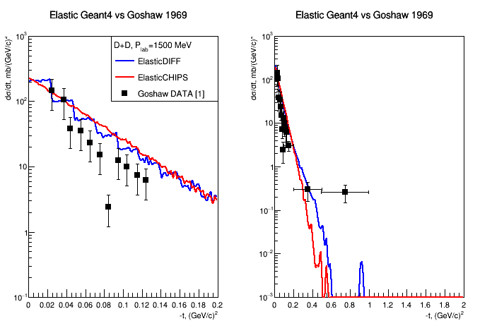
Results for Plab=1500 MeV
[1] A. T. Goshaw, P. J. Oddone, M. J. Bazin, and C. R. Sun Phys. Rev. Lett. 23, 990 (1969)

Slide 8
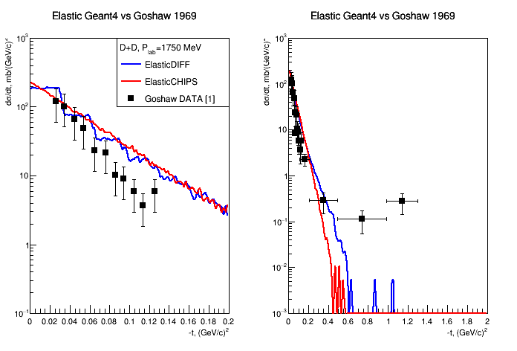
Results for Plab=1750 MeV
[1] A. T. Goshaw, P. J. Oddone, M. J. Bazin, and C. R. Sun Phys. Rev. Lett. 23, 990 (1969)

Slide 9
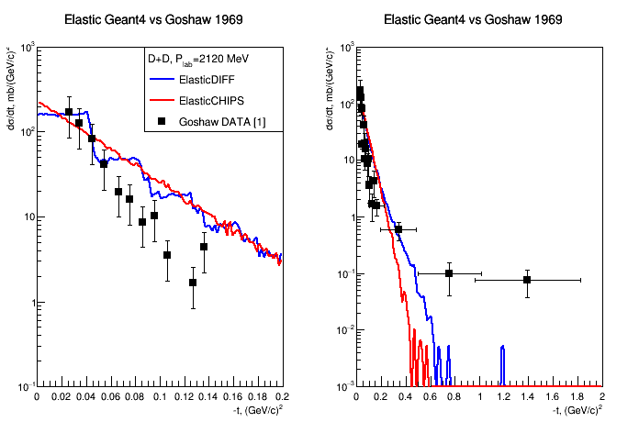
Results for Plab=2120 MeV
[1] A. T. Goshaw, P. J. Oddone, M. J. Bazin, and C. R. Sun Phys. Rev. Lett. 23, 990 (1969)

Slide 10
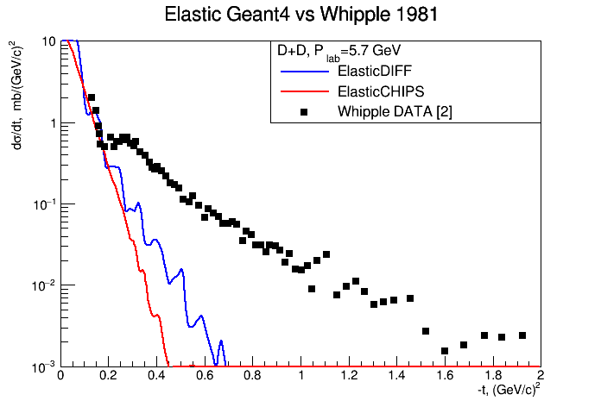
Results for Plab=5.7 GeV
[2] E. T. Whipple et. al., Phys. Rev. Lett. 47, 774 – Published 14 September, 1981

Slide 11
Conclusion
Geant4 FTF is applicable for calculations of inelastic deuteron-deuteron interactions
Geant4 FTF and UrQMD also does not describe quasielastic processes well due to the low number of such interactios
Geant4 models for elastic interactions (DIFF, CHIPS) describe elastic interactions at low t well
But, the do not describe d+d interactions at higher t correctly. This is due to the fact that none of the models available in Geant4 are suitable for modeling elastic processes with deuterons
To describe and model elastic and quasi-elastic d+d interactions, it is necessary to develop existing theoretical approaches

Slide 12
Thank you for your attention!

