Slide 1
REPORT
01.04.2025
Ilia Polishchuk

Slide 2
ATLAS

Slide 3
Current state of task
Data is still being processed. Some jobs consumed a lot of memory. I redefined job sizing to avoid this. So far ~23% of the dataset is done
Acceptance calculation has been adjusted, some mistakes were fixed
J/Psi cross sections are calculated for processed data. Not enough statistics for ρ, ω and φ- mesons

Slide 4
Acceptance
Total acceptance for trigger chain HLT_2mu14_L12MU8F is calculated for following fiducial regions:
21 regions of $p_{T}$ ranging from 28 GeV to 110 GeV
5 regions of $\left|η\right|$ ranging from 0.0 to 2.5
In each bin fit is performed and yields are rocorded

Slide 5
Acceptance
The total acceptance A is defined as the fraction of the number of simulated decays in
the probe sample divided by
the total number of simulated decays.
$$\begin{aligned}A= A_{kin}∗ε_{rec}∗ε_{trig}\#\#\#\#\#\#\#\#\left(1\right)\#\end{aligned}$$
Where $A_{kin}$ is probability that J/ψ passes the following acceptance selections imposed on the two muons depending:
$p_{T}\left(μ_{1}\right)>14 GeV,p_{T}\left(μ_{2}\right)>14 GeV;$ $\left|η\left(μ_{1}\right)\right|<2.5,\left|η\left(μ_{2}\right)\right|<2.5$
$$ε_{rec}=\frac{N_{rec}}{N_{true}}, ε_{trig}=\frac{N_{trig}}{N_{rec}}$$
Trigger chain: HLT_2mu14_L12MU8F

Slide 6
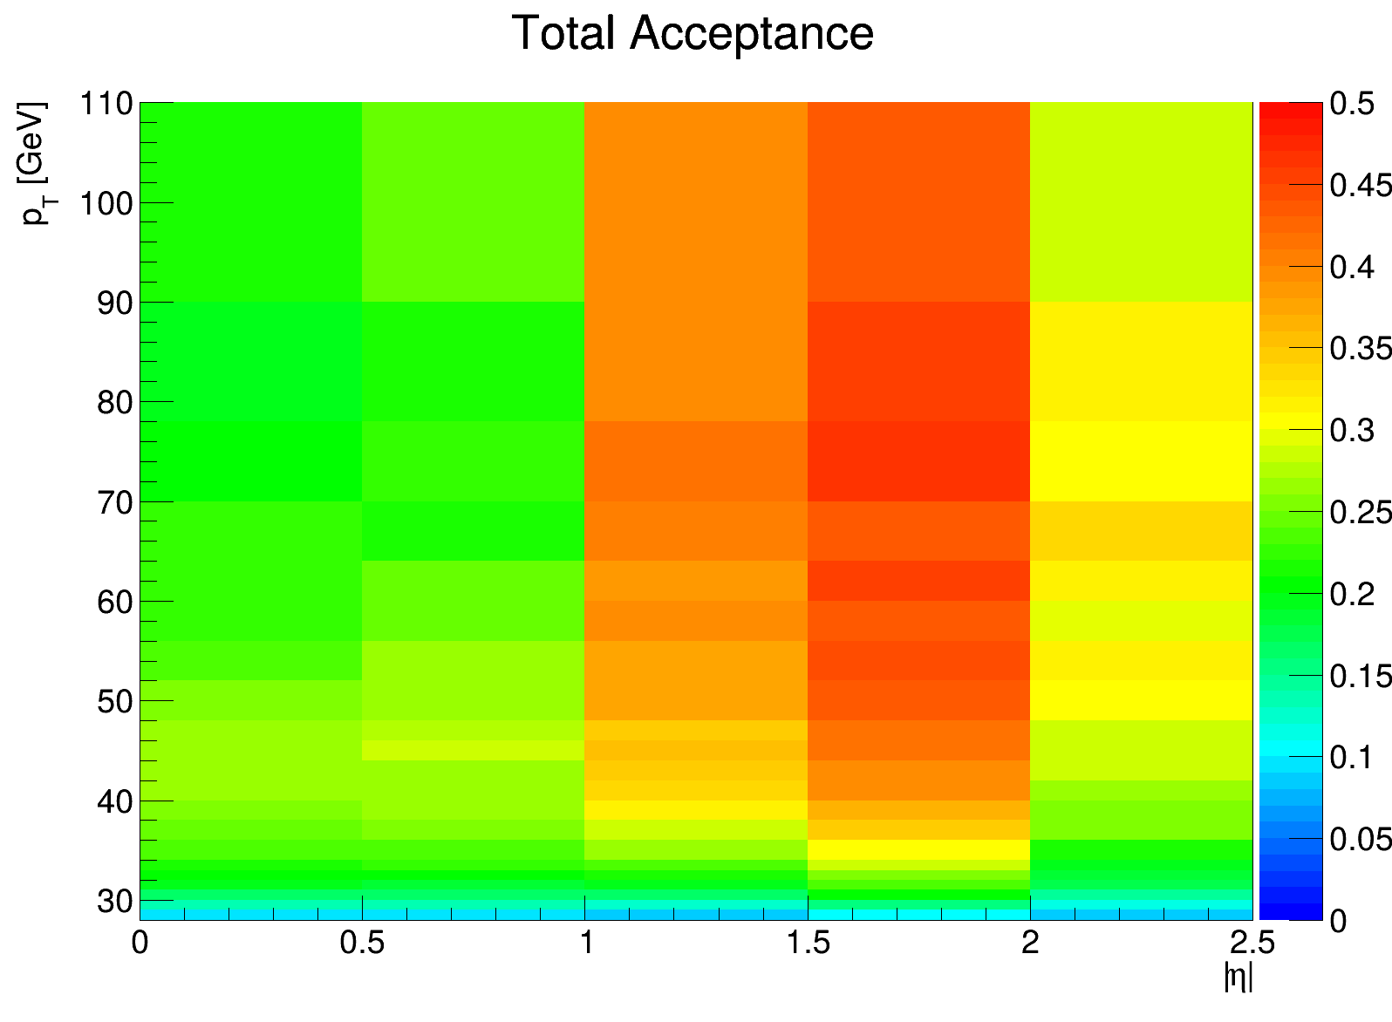
Total Acceptance

Slide 7
Cross sections
Differential cross section $\frac{dσ}{dp_{T}}$ of $J/ψ→μμ$ is calculated using formula:
$$\begin{aligned}\frac{dσ}{dp_{T}}\left(J/ψ→μμ\right)=\frac{N_{pT}^{yield}}{A_{pT}∗L∗∆p_{T}}\#\#(2)\end{aligned}$$
Where $N_{pT}^{yield}−$ total yield of signal in $p_{T}$ bin, $L=35.7{fb}^{−1}−$ integrated luminosity, $∆p_{T}−$ width of $p_{T}$ bin.
For $\frac{dσ}{d\left|η\right|}$ I used following formula:
$$\begin{aligned}\frac{dσ}{d\left|η\right|}\left(J/ψ→μμ\right)=\frac{N_{η}^{yield}}{A_{\left|η\right|}∗L∗∆η}\#\#(3)\end{aligned}$$
Where $N_{η}^{yield}−$ total yield of signal in $y$ bin $∆η−$ width of $y$ bin.
Double differential cross section $\frac{d^{2}σ}{d\left|η\right|dp_{T}}$ of $J/ψ→μμ$ is calculated using formula:
$$\begin{aligned}\frac{d^{2}σ}{d\left|η\right|dp_{T}}\left(J/ψ→μμ\right)=\frac{N_{η,pT}^{yield}}{A_{η,pT}∗L∗∆p_{T}∗∆η}\#\#(4)\end{aligned}$$

Slide 8
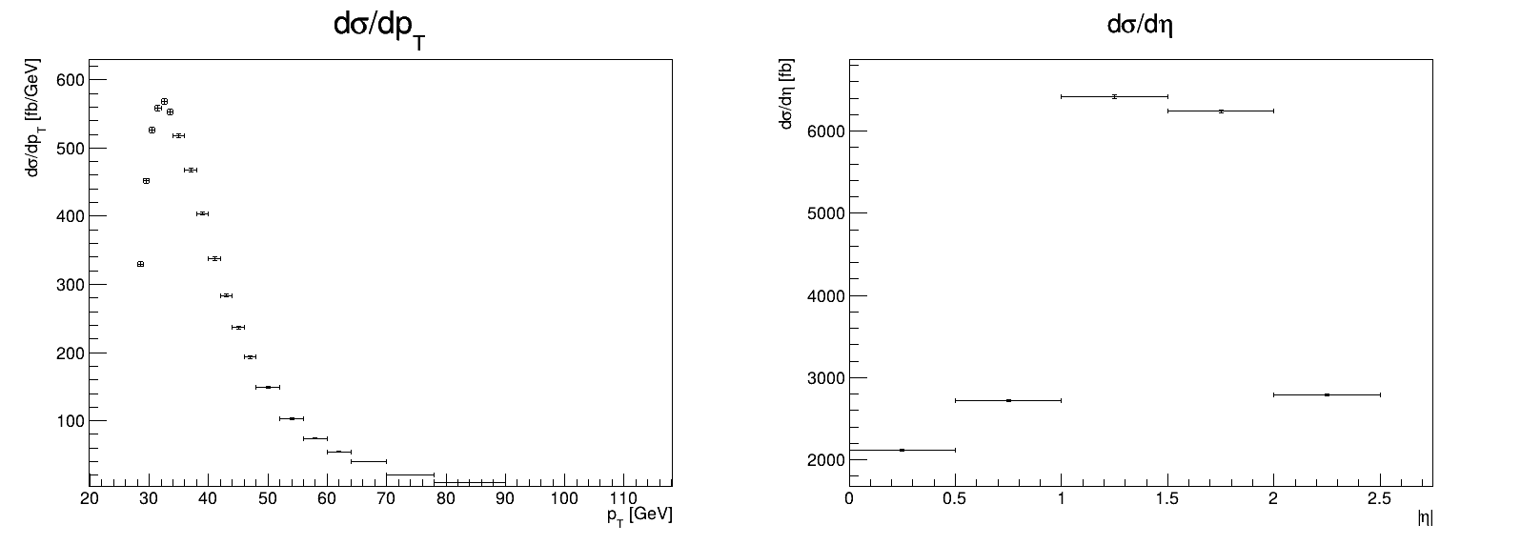
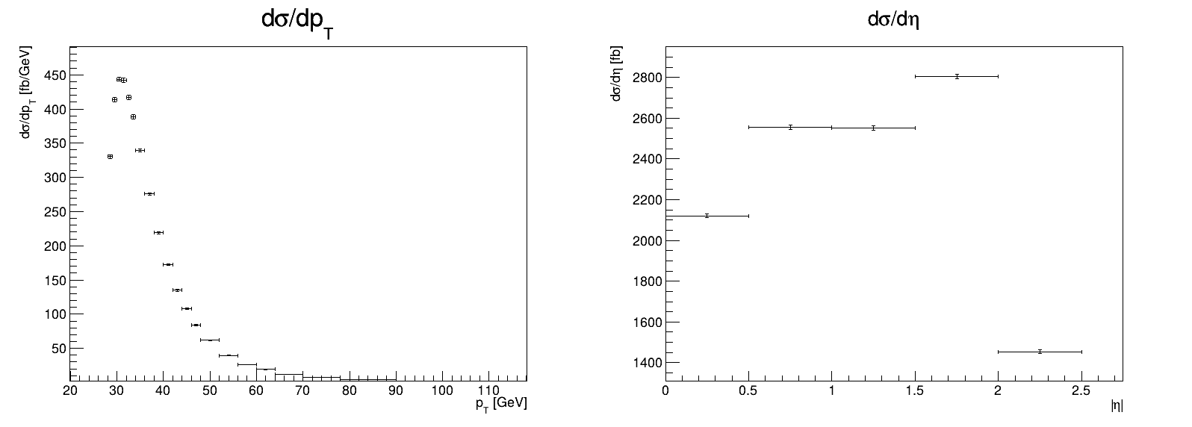
Differential cross sections
Data without acceptance
Monte Carlo

Slide 9
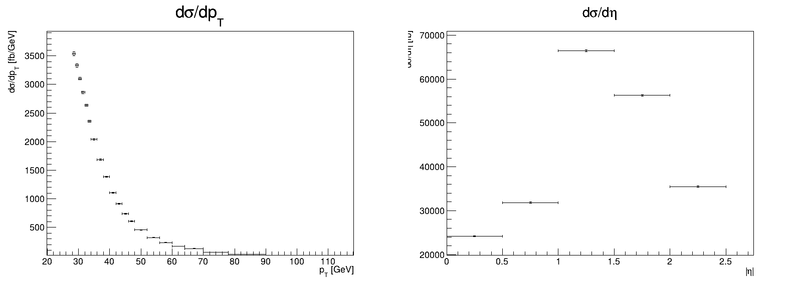
Differential cross sections
Data with acceptance
Monte Carlo

Slide 10
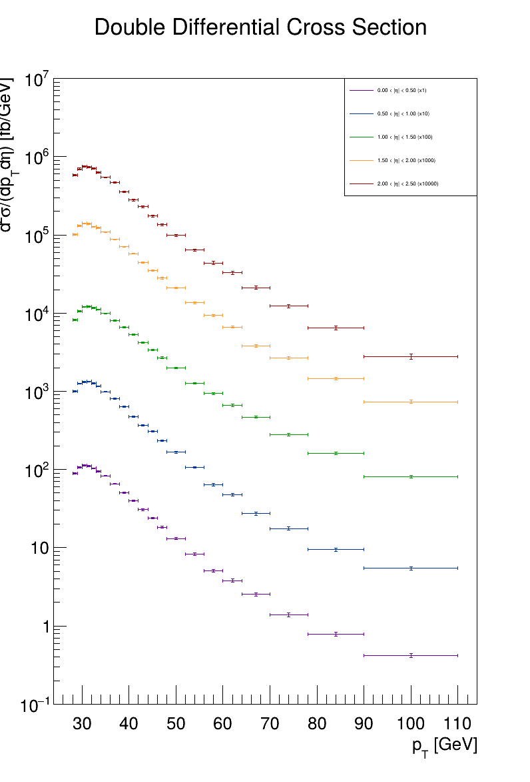
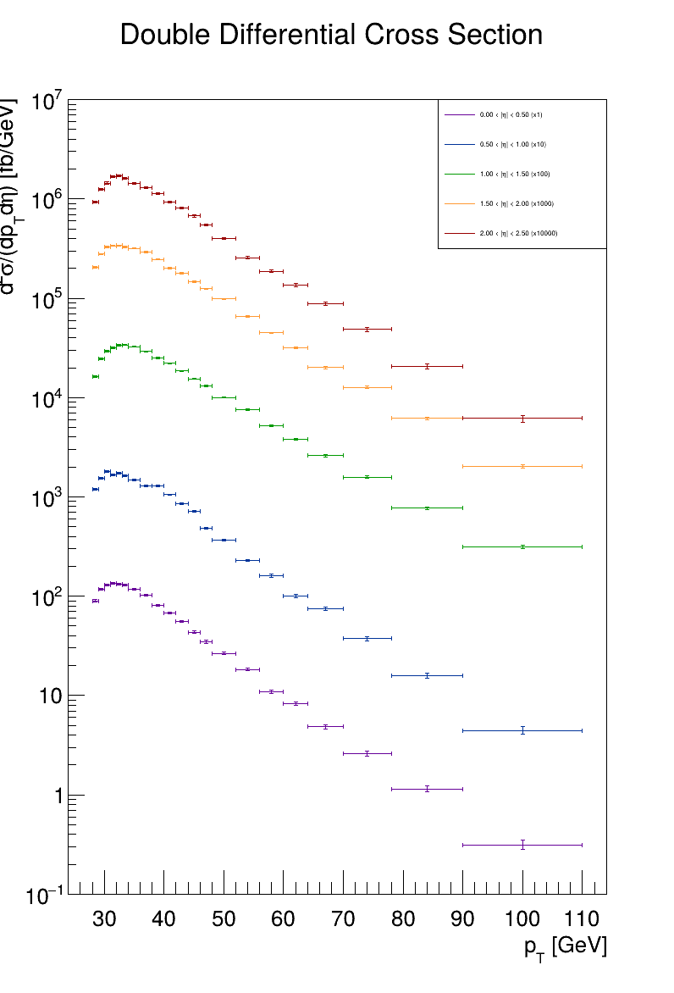
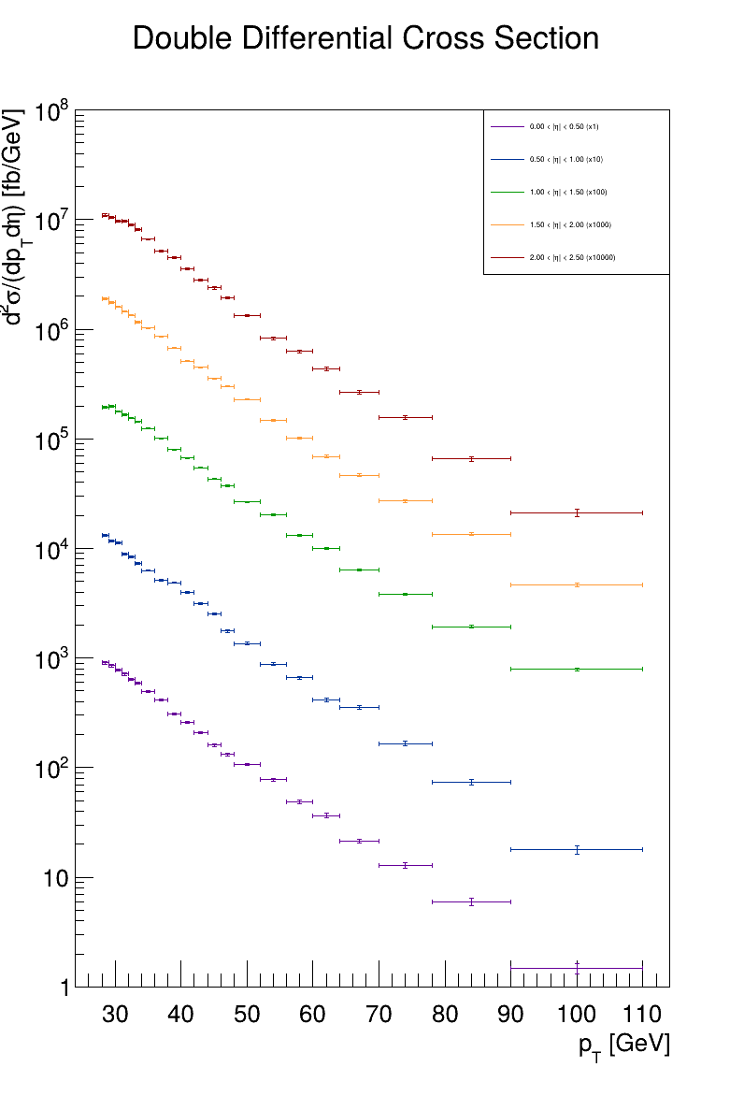
Double Differential cross sections (log scale)
Monte Carlo
Data without acceptance
Data with acceptance

Slide 11
THANK YOU FOR YOUR ATTENTION

