Slide 1
REPORT
18.03.2025
Ilia Polishchuk

Slide 2
ATLAS

Slide 3
Acceptance
The total acceptance A is defined as the fraction of the number of simulated decays in
the probe sample divided by
the total number of simulated decays.
$$\begin{aligned}A= A_{kin}∗ε_{rec}∗ε_{trig}\#\#\#\#\#(1)\end{aligned}$$
Where $A_{kin}$ is probability that J/ψ passes the following acceptance selections imposed on the two muons:
$p_{T}\left(μ_{1}\right)>11 GeV,p_{T}\left(μ_{2}\right)>6 GeV;$ $\left|η\left(μ_{1}\right)\right|<2.5,\left|η\left(μ_{2}\right)\right|<2.5$
$$ε_{rec}=\frac{N_{rec}}{N_{true}}, ε_{trig}=\frac{N_{trig}}{N_{rec}}$$
Trigger chain: HLT_mu11_mu6_bJpsimumu_L1MU8VF_2MU5VF

Slide 4
Acceptance
Total acceptance is calculated for following fiducial regions:
20 regions of $p_{T}$ ranging from 30 GeV to 80 GeV
5 regions of $\left|η\right|$ ranging from 0.0 to 2.5
Average total acceptance is:
$$\left\langle A_{pT}\right\rangle =82.4354 \%$$
$$\left\langle A_{η}\right\rangle =85.8335 \%$$
$$\left\langle A_{η,pT}\right\rangle =74.1580 \%$$

Slide 5
Cross sections
Differential cross section $\frac{dσ}{dp_{T}}$ of $J/ψ→μμ$ is calculated using formula:
$$\begin{aligned}\frac{dσ}{dp_{T}}\left(J/ψ→μμ\right)=\frac{N_{pT}^{yield}}{A_{pT}∗L∗∆p_{T}}\#\#(2)\end{aligned}$$
Where $N_{pT}^{yield}−$ total yield of signal in $p_{T}$ bin, $L=35.7{fb}^{−1}−$ integrated luminosity, $∆p_{T}−$ width of $p_{T}$ bin.
For $\frac{dσ}{d\left|η\right|}$ I used following formula:
$$\begin{aligned}\frac{dσ}{d\left|η\right|}\left(J/ψ→μμ\right)=\frac{N_{η}^{yield}}{A_{\left|η\right|}∗L∗∆η}\#\#(3)\end{aligned}$$
Where $N_{η}^{yield}−$ total yield of signal in $y$ bin $∆η−$ width of $y$ bin.
Double differential cross section $\frac{d^{2}σ}{d\left|η\right|dp_{T}}$ of $J/ψ→μμ$ is calculated using formula:
$$\begin{aligned}\frac{d^{2}σ}{d\left|η\right|dp_{T}}\left(J/ψ→μμ\right)=\frac{N_{η,pT}^{yield}}{A_{η,pT}∗L∗∆p_{T}∗∆η}\#\#(4)\end{aligned}$$

Slide 6
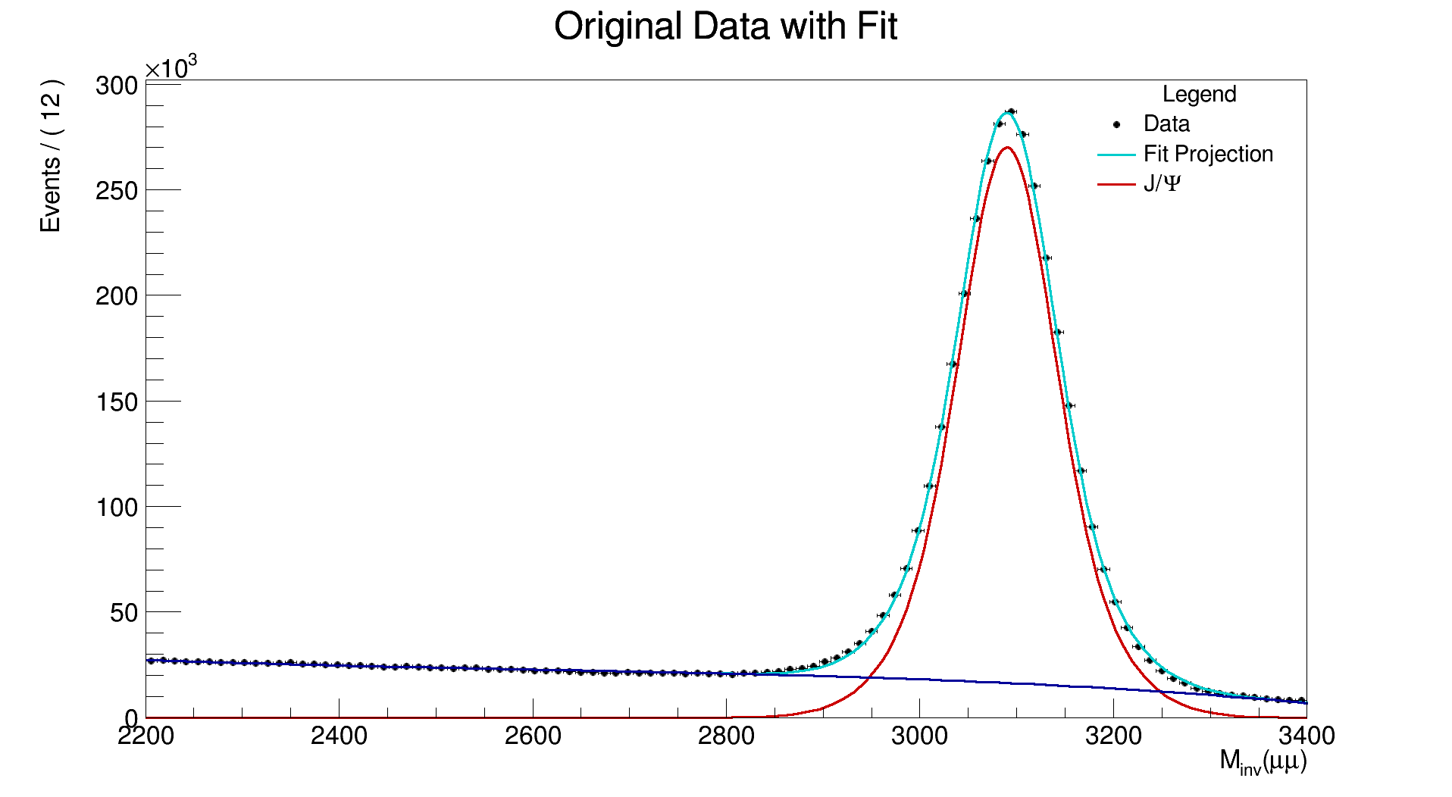
J/Ψ

Slide 7
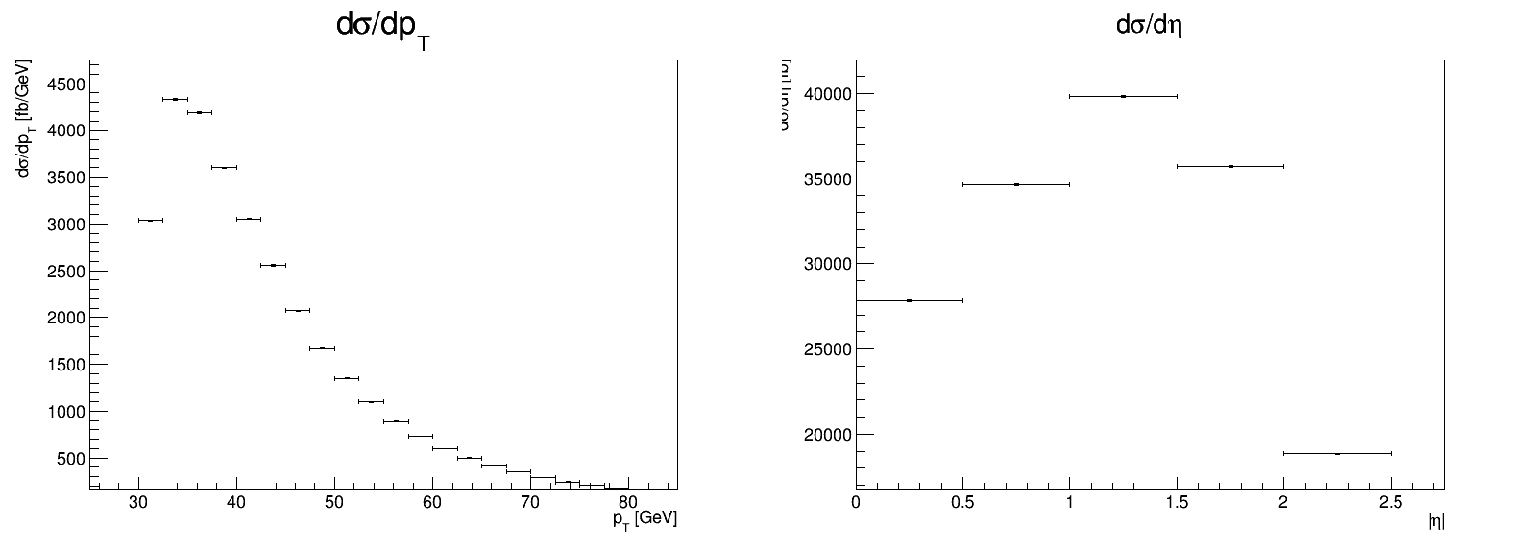
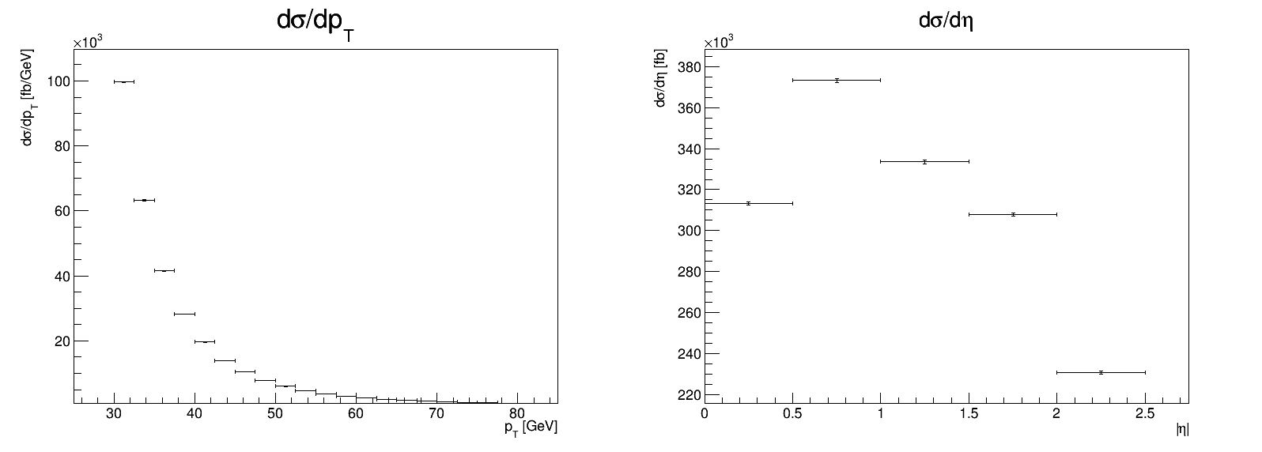
Differential cross sections
Data without acceptance
Monte Carlo pt>5 GeV

Slide 8
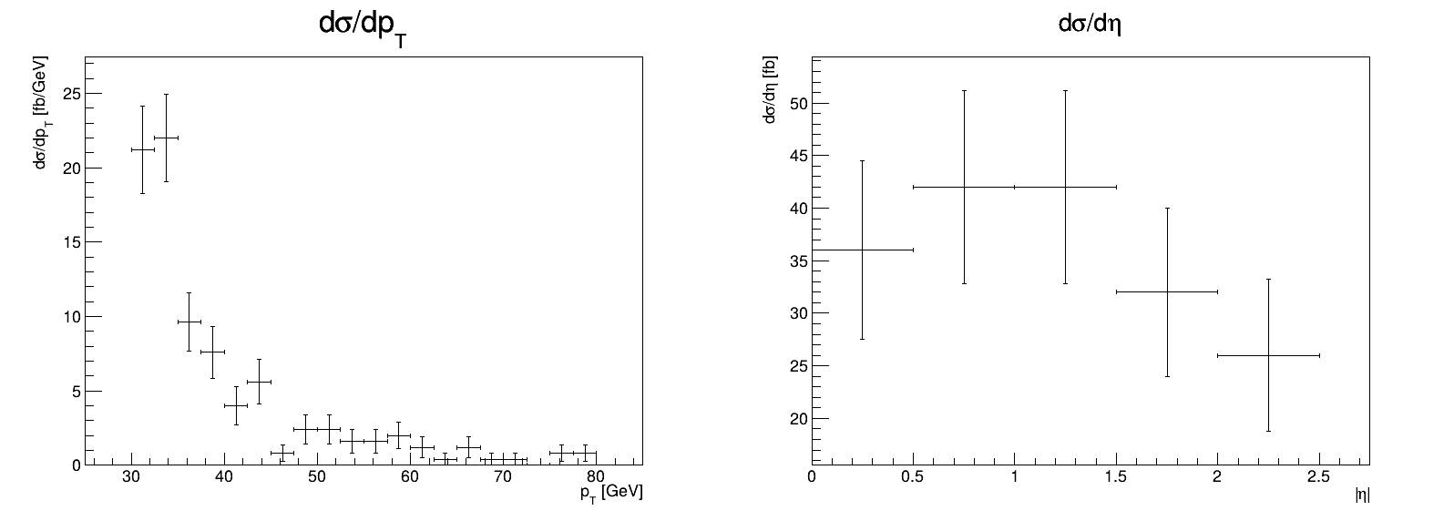
Differential cross sections
Data without acceptance
Monte Carlo pt > 10 GeV

Slide 9
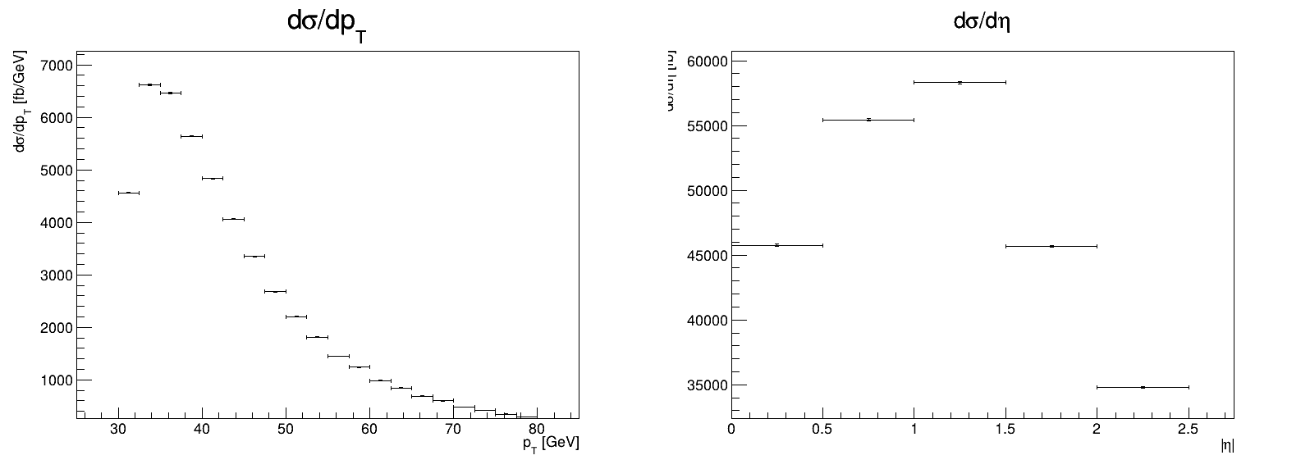
Differential cross sections
Data without acceptance
Data with acceptance

Slide 10
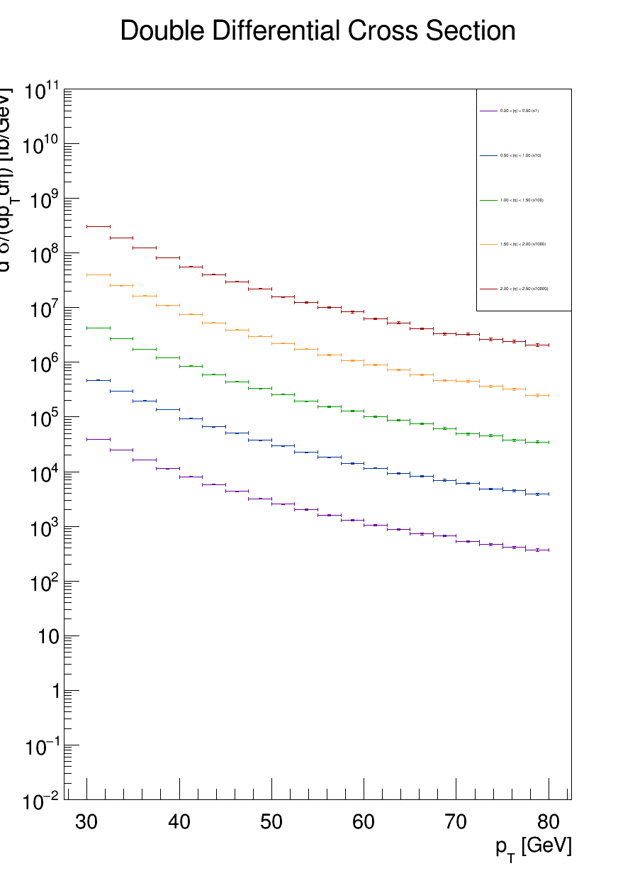
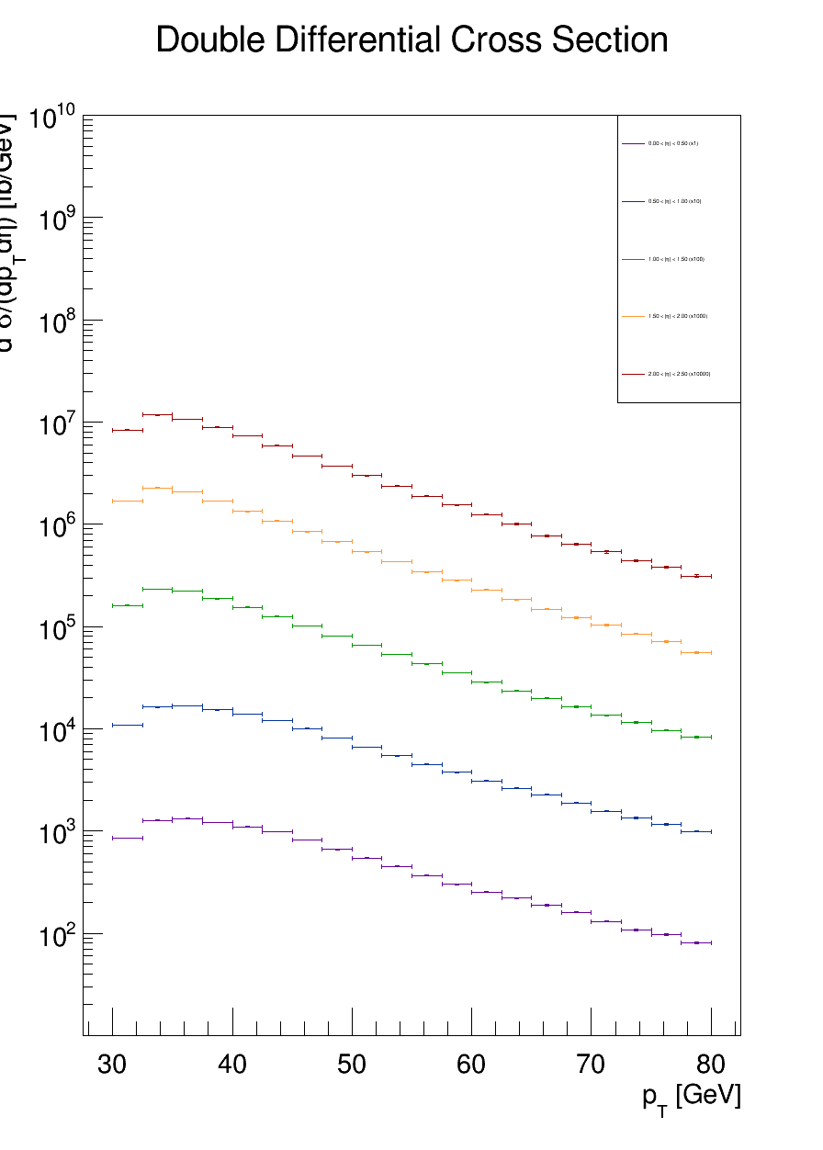
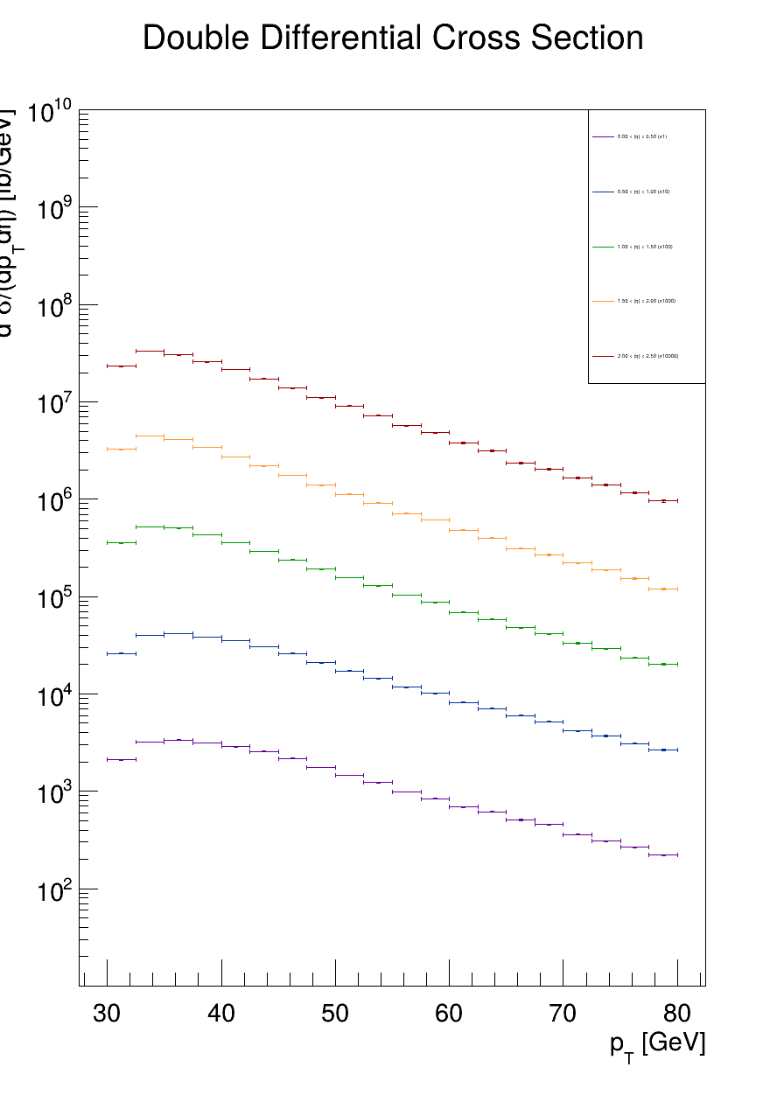
Double Differential cross sections (log scale)
Monte Carlo
Data without acceptance
Data with acceptance

Slide 11
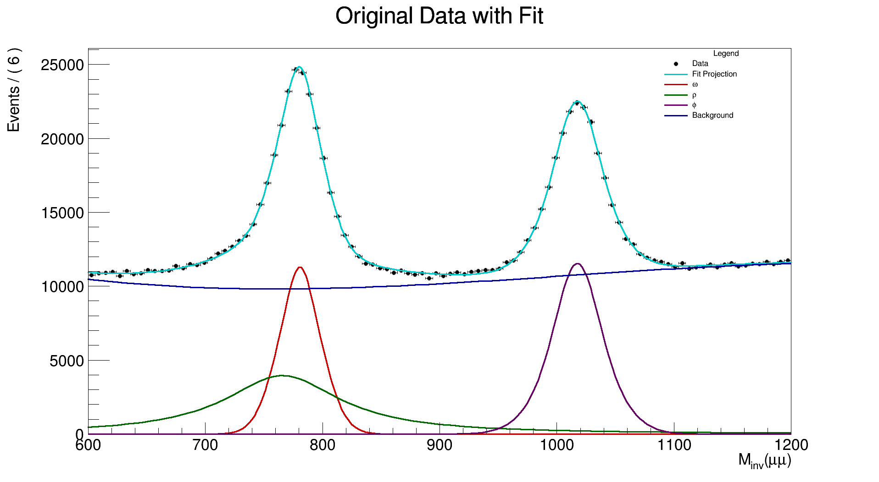
Omega, rho and phi mesons
!

Slide 12
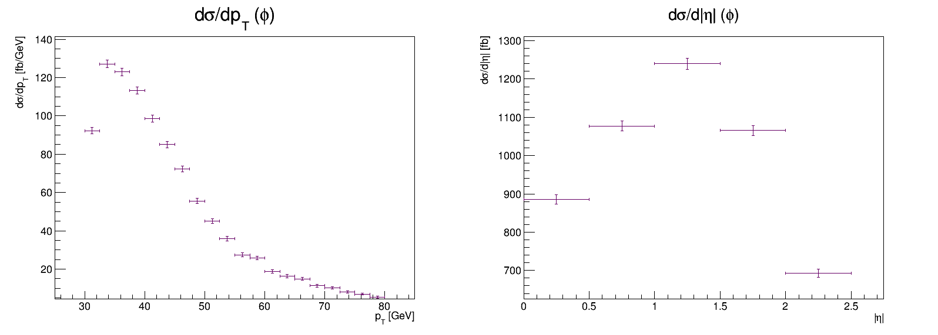
Differential cross sections
J/Psi data without acceptance
phi - meson

Slide 13
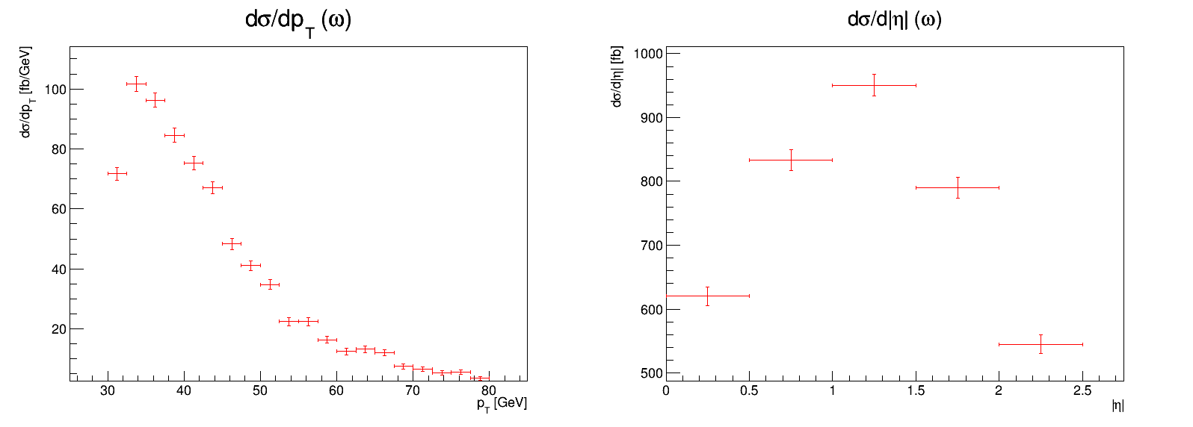
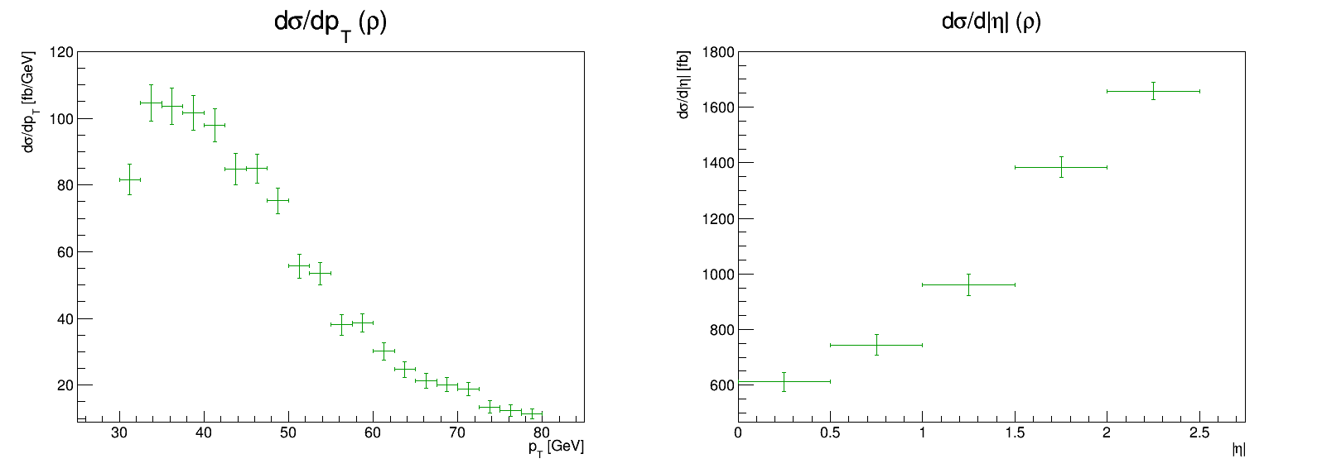
Differential cross sections
omega
rho!

Slide 14
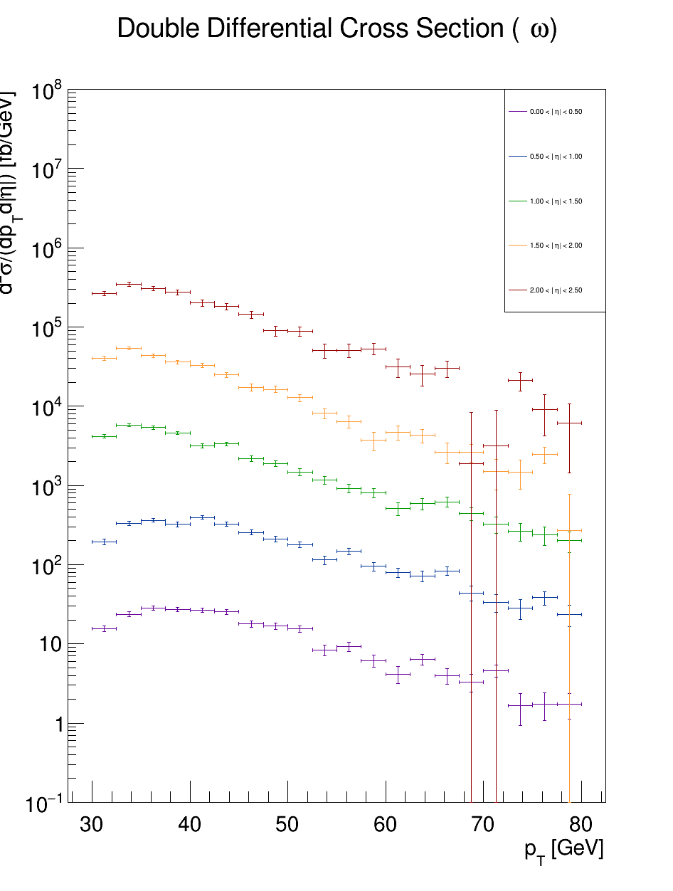
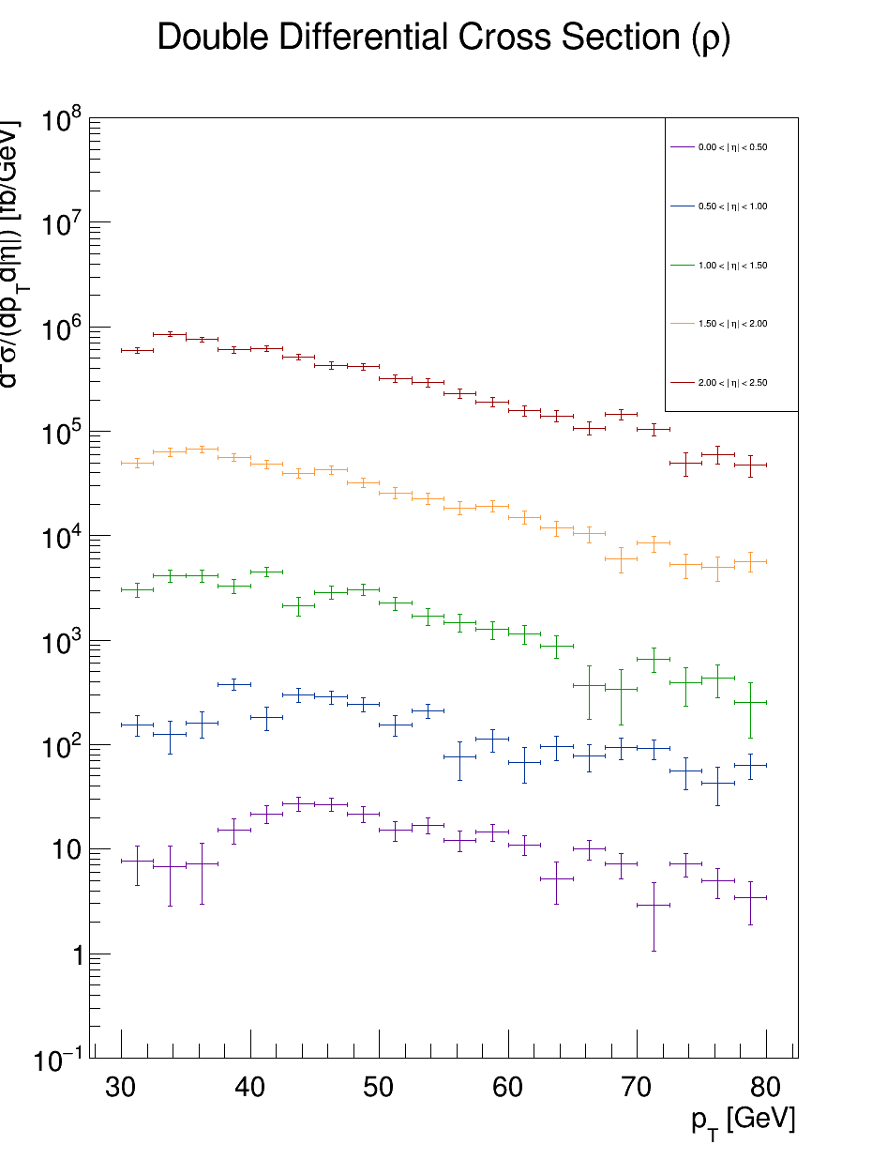
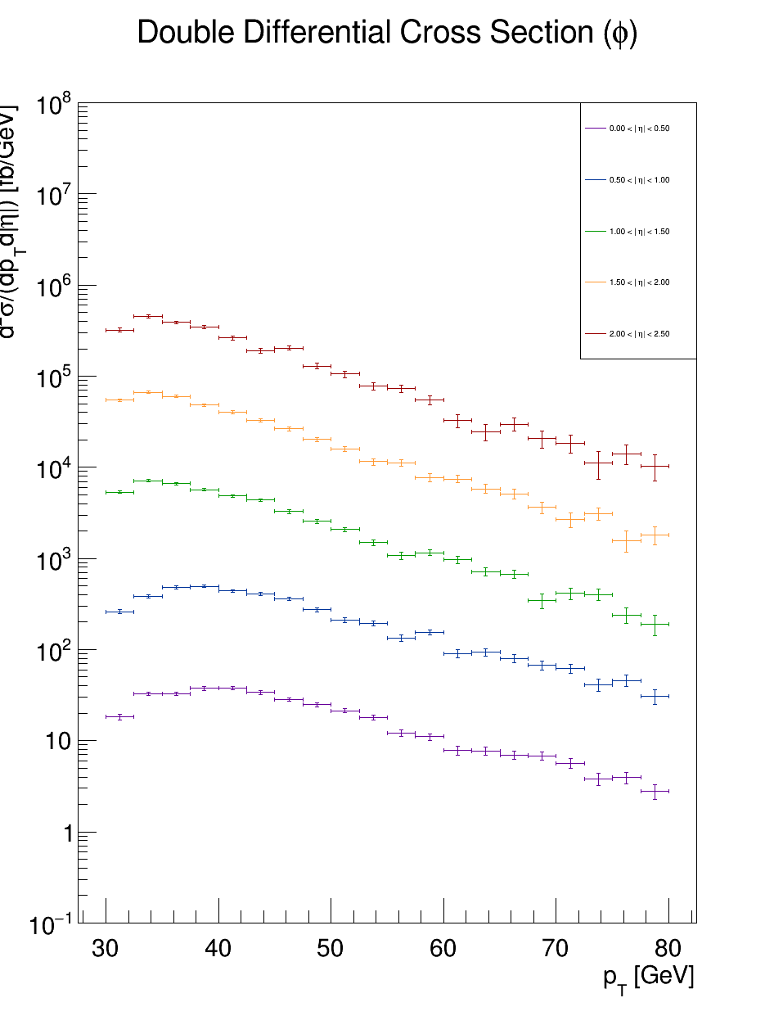
Double Differential cross sections (log scale)
Monte Carlo
Data without acceptance
Data with acceptance

Slide 15
THANK YOU FOR YOUR ATTENTION

